Slide 1

Working with Abstraction
Architecture, Refactoring and Enumerations
SoftUni Team
Technical Trainers
Software University
https://softuni.bg

Slide 2
Table of Contents
Project Architecture
Methods
Classes
Projects
Code Refactoring
Enumerations
Static Keyword
Java Packages

Slide 3
Have a Question?
sli.do
#java-advanced

Slide 4

Project Architecture

Slide 5
Splitting Code into Methods (1)
We use methods to split code into functional blocks
Improves code readability
Allows for easier debugging
for (char move : moves){
for (int r = 0; r < room.length; r++)
for (int c = 0; c < room[r].length; c++)
if (room[row][col] == 'b')
…
}
for (char move : moves) {
moveEnemies();
killerCheck();
movePlayer(move);
}

Slide 6
Splitting Code into Methods (2)
Methods let us easily reuse code
We change the method once to affect all calls
BankAccount bankAcc = new BankAccount();
bankAcc.setId(1);
bankAcc.deposit(20);
System.out.printf("Account %d, balance %d",
bankAcc.getId(),bankAcc.getBalance());
bankAcc.withdraw(10);
…
System.out.println(bankAcc.toString());
Override .toString() to set a global printing format

Slide 7


Splitting Code into Methods (3)
A single method should complete a single task
void doMagic ( … )
void depositOrWithdraw ( … )
BigDecimal depositAndGetBalance ( … )
String parseDataAndReturnResult ( … )
void withdraw ( … )
void deposit ( … )
BigDecimal getBalance ( … )
string toString ( … )

Slide 8
Problem: Rhombus of Stars
Draw on the console a rhombus of stars with size n
n = 3
n = 2
n = 1
*
* *
* * *
* *
*
*
* *
*
*
Check your solution here :https://judge.softuni.bg/Contests/1575/Working-with-Abstraction-Lab

Slide 9
Solution: Rhombus of Stars (1)
int size = Integer.parseInt(sc.nextLine());
for (int starCount = 1; starCount <= size; starCount++) {
printRow(size, starCount);
}
for (int starCount = size - 1; starCount >= 1; starCount--) {
printRow(size, starCount);
}
Reusing code
Check your solution here :https://judge.softuni.bg/Contests/1575/Working-with-Abstraction-Lab

Slide 10
Solution: Rhombus of Stars (2)
static void printRow(int figureSize, int starCount) {
for (int i = 0; i < figureSize - starCount; i++)
System.out.print(" ");
for (int col = 1; col < starCount; col++) {
System.out.print("* ");
}
System.out.println("*");
}
Check your solution here :https://judge.softuni.bg/Contests/1575/Working-with-Abstraction-Lab

Slide 11
Splitting Code into Classes (1)
Just like methods, classes should not know or do too much
GodMode master = new GodMode();
int[] numbers = master.parseAny(input);
...
int[] numbers2 = master.copyAny(numbers);
master.printToConsole(master.getDate());
master.printToConsole(numbers);
11

Slide 12
Splitting Code into Classes (2)
We can also break our code up logically into classes
Hiding implementation
Allow us to change output destination
Helps us to avoid repeating code

Slide 13
Splitting Code into Classes (3)
List<Integer> input = Arrays.stream(
sc.nextLine().split(" "))
.map(Integer::parseInt)
.collect(Collectors.toList());
...
String result = input.stream()
.map(String::valueOf)
.collect(Collectors.joining(", "));
System.out.println(result);
ArrayParser parser = new ArrayParser();
OuputWriter printer = new OuputWriter();
int[] numbers = parser.integersParse(args);
int[] coordinates = parser.integerParse(args1);
printer.printToConsole(numbers);

Slide 14
Problem: Point in Rectangle
Create a Point class holding the horizontal and vertical coordinates
Create a Rectangle class
Holds 2 points
Bottom left and top right
Add Contains method
Takes a Point as an argument
Returns it if it’s inside the current object of the Rectangle class
Check your solution here :https://judge.softuni.bg/Contests/1575/Working-with-Abstraction-Lab

Slide 15
Solution: Point in Rectangle
public class Point {
private int x;
private int y;
//TODO: Add getters and setters
}
public class Rectangle {
private Point bottomLeft;
private Point topRight;
//TODO: getters and setters
public boolean contains(Point point) {
//TODO: Implement
}
}
Check your solution here :https://judge.softuni.bg/Contests/1575/Working-with-Abstraction-Lab

Slide 16
Solution: Point in Rectangle (2)
public boolean contains(Point point)
{
boolean isInHorizontal =
this.bottomLeft.getX() <= point.getX() &&
this.topRight.getX() >= point.getX();
boolean isInVertical =
this.bottomLeft.getY() <= point.getY() &&
this.topRight.getY() >= point.getY();
boolean isInRectangle = isInHorizontal && isInVertical;
return isInRectangle;
}
Check your solution here :https://judge.softuni.bg/Contests/1575/Working-with-Abstraction-Lab

Slide 17

Refactoring

Slide 18
Refactoring
Restructures code without changing the behaviour
Improves code readability
Reduces complexity
class ProblemSolver { public static void doMagic() { … } }
class CommandParser {
public static <T> Function<T, T> parseCommand() { … } }
class DataModifier { public static <T> T execute() { … } }
class OutputFormatter { public static void print() { … } }
18

Slide 19
Refactoring Techniques
Breaking code into reusable units
Extracting parts of methods and classes into new ones
deposit()
withdraw()
depositOrWithdraw()
Improving names of variables, methods, classes, etc.
String str;
String name;
Moving methods or fields to more appropriate classes
Car.open()
Door.open()

Slide 20
Problem: Student System
You are given a working Student System project to refactor
Break it up into smaller functional units and make sure it works
It supports the following commands:
"Create <studentName> <studentAge> <studentGrade>"
creates a new student
"Show <studentName>"
prints information about a student
"Exit"
closes the program
Check your solution here :https://judge.softuni.bg/Contests/1575/Working-with-Abstraction-Lab

Slide 21
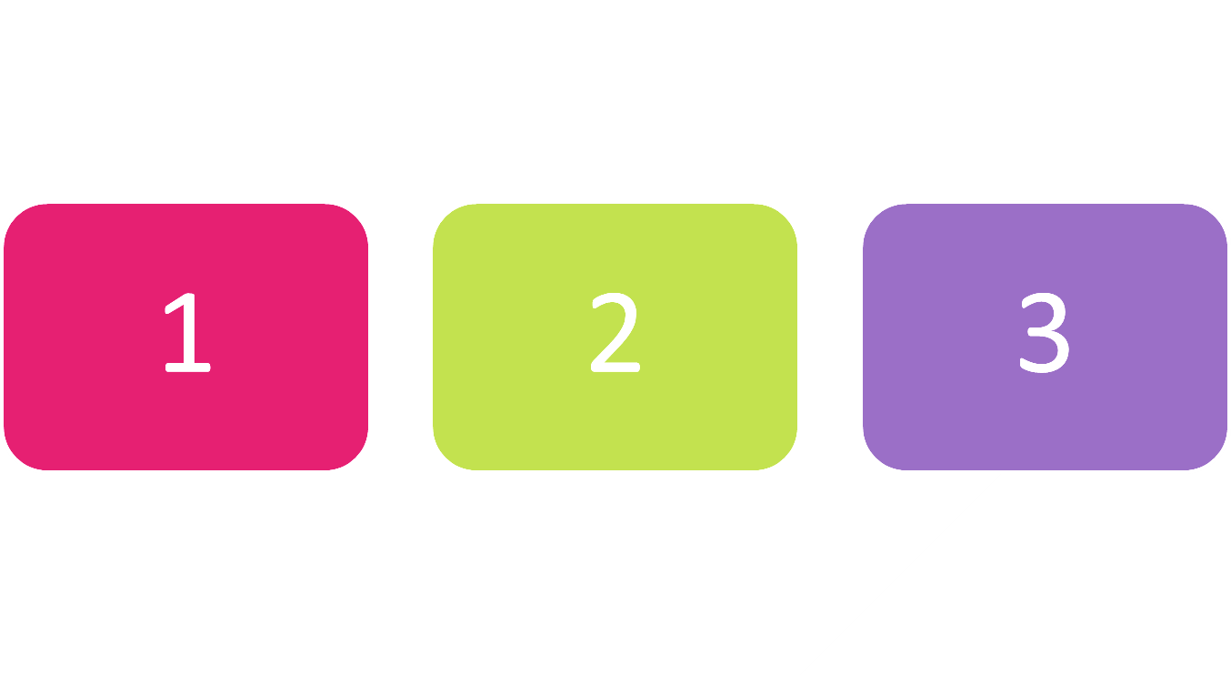
Enumerations

Slide 22
Enumerations
Represent a numeric value from a fixed set as a text
We can use them to pass arguments to methods without making code confusing
By default enums start at 0
Every next value is incremented by 1
enum Day {Mon, Tue, Wed, Thu, Fri, Sat, Sun}
GetDailySchedule(0)
GetDailySchedule(Day.Mon)
22

Slide 23



Enumerations (1)
We can customize enum values
enum Day {
Mon(1),Tue(2),Wed(3),Thu(4),Fri(5),Sat(6),Sun(7);
private int value;
Day(int value) {
this.value = value;
}
}
System.out.println(Day.Sat); // Sat

Slide 24
Enumerations (2)
We can customize enum values
enum CoffeeSize {
Small(100), Normal(150), Double(300);
private int size;
CoffeeSize(int size) {
this.size = size;
}
public int getValue() { return this.size; }
}
System.out.println(CoffeeSize.Small.getValue()); // 100

Slide 25

Problem: Hotel Reservation
Create a class PriceCalculator that calculates the total price of a holiday, by given price per day, number of days, the season and a discount type
The discount type and season should be enums
The price multipliers will be:
1x for Autumn, 2x for Spring, etc.
The discount types will be:
None – 0%
SecondVisit – 10%
VIP – 20%
Check your solution here :https://judge.softuni.bg/Contests/1575/Working-with-Abstraction-Lab

Slide 26
Solution: Hotel Reservation (1)
public enum Season {
Spring(2), Summer(4), Autumn(1), Winter(3);
private int value;
Season(int value) {
this.value = value;
}
public int getValue() {
return this.value;
}
}
Check your solution here :https://judge.softuni.bg/Contests/1575/Working-with-Abstraction-Lab

Slide 27
Solution: Hotel Reservation (2)
public enum Discount {
None(0), SecondVisit(10), VIP(20);
private int value;
Discount(int value) {
this.value = value;
}
public int getValue() {
return this.value;
}
}
Check your solution here :https://judge.softuni.bg/Contests/1575/Working-with-Abstraction-Lab

Slide 28
Solution: Hotel Reservation (3)
public class PriceCalculator {
public static double CalculatePrice(double pricePerDay,
int numberOfDays, Season season, Discount discount) {
int multiplier = season.getValue();
double discountMultiplier = discount.getValue() / 100.0;
double priceBeforeDiscount = numberOfDays * pricePerDay * multiplier;
double discountedAmount = priceBeforeDiscount * discountMultiplier;
return priceBeforeDiscount - discountedAmount;
}
}
Check your solution here :https://judge.softuni.bg/Contests/1575/Working-with-Abstraction-Lab

Slide 29

Static Keyword in Java

Slide 30
Static Keyword
Used for memory management mainly
Can apply with:
Nested class
Variables
Methods
Blocks
Belongs to the class than an instance of the class
static int count;
static void increaseCount() {
count++;
}
30

Slide 31
Static Class
A top level class is a class that is not a nested class
A nested class is any class whose declaration occurs within the body of another class or interface
Only nested classes can be static
class TopClass {
static class NestedStaticClass {
}
}
31

Slide 32
Static Variable
Can be used to refer to the common variable of all objects
Example
The company name of employees
College name of students
Name of the college is common for all students
Allocate memory only once in class area at the time of class loading
32

Slide 33
Example: Static Variable (1)
class Counter {
int count = 0; static int staticCount = 0;
public Counter() {
count++; // incrementing value
staticCount++; // incrementing value
}
public void printCounters() {
System.out.printf("Count: %d%n", count);
System.out.printf("Static Count: %d%n", staticCount);
}
}
33

Slide 34
Example: Static Variable (2)
// Inside the Main Class
public static void main(String[] args) {
Counter c1 = new Counter();
c1.printCounters();
Counter c2 = new Counter();
c2.printCounters();
Counter c3 = new Counter();
c3.printCounters();
int counter = Counter.staticCount; // 3
}
Count: 1
Static Count: 1
Count: 1
Static Count: 2
Count: 1
Static Count: 3
34

Slide 35
Static Method
Belongs to the class rather than the object of a class
Can be invoked without the need for creating an instance of a class
Can access static data member and can change the value of it
Can not use non-static data member or call non-static method directly
this and super cannot be used in static context
35

Slide 36
Example: Static Method
class Calculate {
static int cube(int x) { return x * x * x; }
public static void main(String args[]) {
int result = Calculate.cube(5);
System.out.println(result); // 125
System.out.println(Math.pow(2, 3)); // 8.0
}
}
36

Slide 37
Static Block
A set of statements, which will be executed by the JVM before execution of main method
Executing static block is at the time of class loading
A class can take any number of static block but all blocks will be executed from top to bottom
37

Slide 38
Example: Static Block
class Main {
static int n;
public static void main(String[] args) {
System.out.println("From main");
System.out.println(n);
}
static {
System.out.println("From static block");
n = 10;
}
}
From static block
From main
10
38

Slide 39

Packages

Slide 40
Packages in Java
Used to group related classes
Like a folder in a file directory
Use packages to avoid name conflicts and to write a better maintainable code
Packages are divided into two categories:
Built-in Packages (packages from the Java API)
User-defined Packages (create own packages)
40

Slide 41
Build-In Packages
The library is divided into packages and classes
Import a single class or a whole package that contain all the classes
To use a class or a package, use the import keyword
The complete list can be found at Oracles website: https://docs.oracle.com/en/java/javase/
import package.name.Class; // Import a single class
import package.name.*; // Import the whole package
41

Slide 42

Summary
…
…
…
Well organized code is easier to work with
We can reduce complexity using Methods, Classes and Projects
We can refactor existing code by breaking code down
Enumerations define a fixed set of constants
Represent numeric values
We can easily cast enums to numeric types
Static members and Packages

Slide 43
Questions?
Notes:
43

Slide 44










SoftUni Diamond Partners

Slide 45



Educational Partners

Slide 46
Trainings @ Software University (SoftUni)
Software University – High-Quality Education, Profession and Job for Software Developers
softuni.bg
Software University Foundation
softuni.foundation
Software University @ Facebook
facebook.com/SoftwareUniversity
Software University Forums
forum.softuni.bg
46
Notes:
46

Slide 47

License
This course (slides, examples, demos, exercises, homework, documents, videos and other assets) is copyrighted content
Unauthorized copy, reproduction or use is illegal
© SoftUni – https://about.softuni.bg
© Software University – https://softuni.bg
Notes:
47

Slide 48
Encapsulation
Benefits of Encapsulation
methods
variables
variables
SoftUni Team
Technical Trainers
Software University
https://softuni.bg

Slide 49

Table of Contents
What is Encapsulation?
Keyword this
Access Modifiers
Validation
Mutable and Immutable Objects
Keyword final

Slide 50
Have a Question?
sli.do
#java-advanced

Slide 51
Hiding Implementation
Abstraction
Data Encapsulation
Information Hiding

Slide 52
Encapsulation
Process of wrapping code and data together into a single unit
Flexibility and extensibility of the code
Reduces complexity
Structural changes remain local
Allows validation and data binding
52
Notes:
Encapsulation hides the implementation details
Class announces only a few operations (methods) available for its clients – its public interface
All data members (fields) of a class should be hidden
Accessed via properties (read-only and read-write)
No interface members should be hidden
Encapsulation == hide (encapsulate) data behind constructors and properties

Slide 53


Encapsulation
Objects fields must be private
Use getters and setters for data access
class Person {
private int age;
}
class Person {
public int getAge()
public void setAge(int age)
}
Notes:
Encapsulation hides the implementation details
Class announces only a few operations (methods) available for its clients – its public interface
All data members (fields) of a class should be hidden
Accessed via properties (read-only and read-write)
No interface members should be hidden
Encapsulation == hide (encapsulate) data behind constructors and properties

Slide 54
Encapsulation – Example
Fields should be private
Accessors and Mutators should be public
Person
-name: string
-age: int
- == private
+Person(String name, int age)
+getName(): String
+setName(String name): void
+getAge(): int
+setAge(int age): void
+ == public
54
Notes:
Fields are private
Constructors and accessors are defined (getters and setters)

Slide 55
Keyword This (1)
this is a reference to the current object
this can refer to current class instance
this can invoke current class method
public Person(String name) {
this.name = name;
}
public String fullName() {
return this.getFirstName() + " " + this.getLastName();
}
Notes:
Constructors are declared public
Constructors perform checks to keep the object state valid
Interface methods are always public
Not explicitly declared with public
Non-interface methods are declared private / protected

Slide 56
Keyword This (2)
this can invoke current class constructor
public Person(String name) {
this.firstName = name;
}
public Person (String name, Integer age) {
this(name);
this.age = age;
}
Notes:
Constructors are declared public
Constructors perform checks to keep the object state valid
Interface methods are always public
Not explicitly declared with public
Non-interface methods are declared private / protected

Slide 57

Access Modifiers

Slide 58
Private Access Modifier
Object hides data from the outside world
Classes and interfaces cannot be private
Data can be accessed only within the declared class itself
class Person {
private String name;
Person (String name) {
this.name = name;
}
}
58
Notes:
Access Level "public"
When we use the modifier public in front of some element, we are telling the compiler, that this element can be accessed from every class, no matter from the current project (assembly), from the current package. The access level public defines the miss of restrictions regarding the visibility. This access level is the least restricted access level in Java.
Access Level "private"
The access level private is the one, which defines the most restrictive level of visibility of the class and its elements. The modifier private is used to indicate, that the element, to which is issued, cannot be accessed from any other class (except the class, in which it is defined), even if this class exists in the same package.
Access Level “protected"
The access level private is the one, which defines the most restrictive level of visibility of the class and its elements. The modifier private is used to indicate, that the element, to which is issued, cannot be accessed from any other class (except the class, in which it is defined), even if this class exists in the same namespace.
Access Level “default"
This is the default access level, i.e. it is used when there is no access level modifier in front of the respective element of a class. Members can be accessed only from the same package.

Slide 59
Protected Access Modifier
Grants access to subclasses
protected modifier cannot be applied to classes and interfaces
Prevents a nonrelated class from trying to use it
class Team {
protected String getName () {…}
protected void setName (String name) {…}
}
59
Notes:
Access Level "public"
When we use the modifier public in front of some element, we are telling the compiler, that this element can be accessed from every class, no matter from the current project (assembly), from the current package. The access level public defines the miss of restrictions regarding the visibility. This access level is the least restricted access level in Java.
Access Level "private"
The access level private is the one, which defines the most restrictive level of visibility of the class and its elements. The modifier private is used to indicate, that the element, to which is issued, cannot be accessed from any other class (except the class, in which it is defined), even if this class exists in the same package.
Access Level “protected"
The access level private is the one, which defines the most restrictive level of visibility of the class and its elements. The modifier private is used to indicate, that the element, to which is issued, cannot be accessed from any other class (except the class, in which it is defined), even if this class exists in the same namespace.
Access Level “default"
This is the default access level, i.e. it is used when there is no access level modifier in front of the respective element of a class. Members can be accessed only from the same package.

Slide 60
Default Access Modifier
Do not explicitly declare an access modifier
Available to any other class in the same package
class Team {
String getName() {…}
void setName(String name) {…}
}
Team real = new Team("Real");
real.setName("Real Madrid");
System.out.println(real.getName());
// Real Madrid
60
Notes:
Access Level "public"
When we use the modifier public in front of some element, we are telling the compiler, that this element can be accessed from every class, no matter from the current project (assembly), from the current package. The access level public defines the miss of restrictions regarding the visibility. This access level is the least restricted access level in Java.
Access Level "private"
The access level private is the one, which defines the most restrictive level of visibility of the class and its elements. The modifier private is used to indicate, that the element, to which is issued, cannot be accessed from any other class (except the class, in which it is defined), even if this class exists in the same package.
Access Level “protected"
The access level private is the one, which defines the most restrictive level of visibility of the class and its elements. The modifier private is used to indicate, that the element, to which is issued, cannot be accessed from any other class (except the class, in which it is defined), even if this class exists in the same namespace.
Access Level “default"
This is the default access level, i.e. it is used when there is no access level modifier in front of the respective element of a class. Members can be accessed only from the same package.

Slide 61
Public Access Modifier
Grants access to any class belonging to the Java Universe
Import a package if you need to use a class
The main() method of an application must be public
public class Team {
public String getName() {…}
public void setName(String name) {…}
}
61
Notes:
Access Level "public"
When we use the modifier public in front of some element, we are telling the compiler, that this element can be accessed from every class, no matter from the current project (assembly), from the current package. The access level public defines the miss of restrictions regarding the visibility. This access level is the least restricted access level in Java.
Access Level "private"
The access level private is the one, which defines the most restrictive level of visibility of the class and its elements. The modifier private is used to indicate, that the element, to which is issued, cannot be accessed from any other class (except the class, in which it is defined), even if this class exists in the same package.
Access Level “protected"
The access level private is the one, which defines the most restrictive level of visibility of the class and its elements. The modifier private is used to indicate, that the element, to which is issued, cannot be accessed from any other class (except the class, in which it is defined), even if this class exists in the same namespace.
Access Level “default"
This is the default access level, i.e. it is used when there is no access level modifier in front of the respective element of a class. Members can be accessed only from the same package.

Slide 62
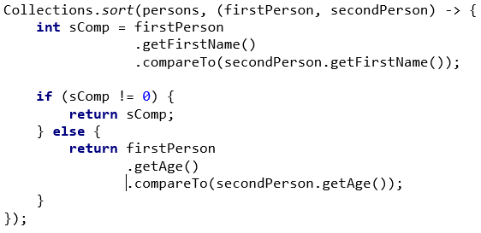
Problem: Sort by Name and Age
Create a class Person
Person
-firstName: String
-lastName: String
-age: int
+getFirstName(): String
+getLastName(): String
+getAge(): int
+toString(): String
Check your solution here: https://judge.softuni.bg/Contests/1535/Encapsulation-Lab

Slide 63
Solution: Sort by Name and Age
public class Person {
private String firstName;
private String lastName; private int age;
// TODO: Implement Constructor
public String getFirstName() { /* TODO */ }
public String getLastName() { /* TODO */ }
public int getAge() { return age; }
@Override
public String toString() { /* TODO */ }
}

Slide 64
Problem: Salary Increase
Implement Salary
Add:
getter for salary
increaseSalary by percentage
Persons younger than 30 get only half of the increase
Person
-firstName: String
-lastName: String
-age: int
-salary: double
+getFirstName(): String
+getLastName() : String
+getAge() : int
+getSalary(): double
+setSalary(double): void
+increaseSalary(double): void
+toString(): String

Slide 65
Solution: Salary Increase (1)
Expand Person from previous task
public class Person {
private double salary;
// Edit Constructor
public double getSalary() {
return this.salary;
}
public void setSalary(double salary) {
this.salary = salary;
}
// Next Slide…
// TODO: Edit toString() method
}
Check your solution here: https://judge.softuni.bg/Contests/1535/Encapsulation-Lab

Slide 66
Solution: Salary Increase (2)
Expand Person from previous task
public void increaseSalary(double percentage) {
if (this.getAge() < 30) {
this.setSalary(this.getSalary() +
(this.getSalary() * percentage / 200));
} else {
this.setSalary(this.getSalary() +
(this.getSalary() * percentage / 100));
}
}
Check your solution here: https://judge.softuni.bg/Contests/1535/Encapsulation-Lab

Slide 67

Validation

Slide 68
Validation (1)
Data validation happens in setters
Printing with System.out couples your class
Client can handle class exceptions
private void setSalary(double salary) {
if (salary < 460) {
throw new IllegalArgumentException("Message");
}
this.salary = salary;
}
It is better to throw exceptions, rather than printing to the Console
Notes:
Constructors are declared public
Constructors perform checks to keep the object state valid
Interface methods are always public
Not explicitly declared with public
Non-interface methods are declared private / protected

Slide 69
Validation (2)
Constructors use private setters with validation logic
Guarantees valid state of object in its creation
Guarantees valid state for public setters
public Person(String firstName, String lastName,
int age, double salary) {
setFirstName(firstName);
setLastName(lastName);
setAge(age);
setSalary(salary);
}
Validation happens inside the setter
Notes:
Constructors are declared public
Constructors perform checks to keep the object state valid
Interface methods are always public
Not explicitly declared with public
Non-interface methods are declared private / protected

Slide 70
Problem: Validation Data
Expand Person with validation for every field
Names should be at least 3 symbols
Age cannot be zero or negative
Salary cannot be less than 460
Person
-firstName : String
-lastName : String
-age : int
-salary : double
+Person()
+setFirstName(String fName)
+setLastName(String lName)
+setAge(int age)
+setSalary(double salary)
Check your solution here: https://judge.softuni.bg/Contests/1535/Encapsulation-Lab

Slide 71
Solution: Validation Data
// TODO: Add validation for firstName
// TODO: Add validation for lastName
public void setAge(int age) {
if (age < 1) {
throw new IllegalArgumentException(
"Age cannot be zero or negative integer");
}
this.age = age;
}
// TODO: Add validation for salary
Check your solution here: https://judge.softuni.bg/Contests/1535/Encapsulation-Lab

Slide 72

Mutable and Immutable Objects

Slide 73
Mutable vs Immutable Objects
Mutable Objects
The contents of that instance can be altered
Immutable Objects
The contents of the instance can't be altered
Point myPoint = new Point(0, 0); myPoint.setLocation(1.0, 0.0);
System.out.println(myPoint);
String str = new String("old String");
System.out.println(str);
str.replaceAll("old", "new");
System.out.println(str);
java.awt.Point[1.0, 0.0]
old String
old String
73

Slide 74

Mutable Fields
private mutable fields are not fully encapsulated
In this case getter is like setter too
class Team {
private String name;
private List<Person> players;
public List<Person> getPlayers() {
return this.players;
}
}
74
Notes:
Fields are always declared private
Accessed through getters and setters in read-only or read-write mode
Setters perform checks to fight invalid data

Slide 75
Mutable Fields – Example
Team team = new Team();
Person person = new Person("David", "Adams", 22);
team.getPlayers().add(person);
System.out.println(team.getPlayers().size()); // 1
team.getPlayers().clear();
System.out.println(team.getPlayers().size()); // 0

Slide 76
Imutable Fields
For securing our collection we can return Collections.unmodifiableList()
class Team {
private List<Person> players;
public void addPlayer(Person person) {
this.players.add(person);
}
public List<Person> getPlayers() {
return Collections.unmodifiableList(players);
}
}
Add new methods for functionality over list
Returns a safe collections
76
Notes:
Fields are always declared private
Accessed through getters and setters in read-only or read-write mode
Setters perform checks to fight invalid data

Slide 77
Problem: First and Reserve Team
Expand your project with class Team
Team have two squads first team and reserve team
Read persons from console and add them to team
If they are younger than 40, they go to first squad
Print both squad sizes
Team
-name: String
-firstTeam: List<Person>
-reserveTeam: List<Person>
+Team(String name)
+getName()
-setName(String name)
+getFirstTeam()
+getReserveTeam()
+addPlayer(Person person)
Check your solution here: https://judge.softuni.bg/Contests/1535/Encapsulation-Lab

Slide 78
Solution: First and Reserve Team
private List<Person> firstTeam;
private List<Person> reserveTeam;
public void addPlayer(Person person) {
if (person.getAge() < 40)
this.firstTeam.add(person);
else
this.reserveTeam.add(person);
}
public List<Person> getFirstTeam() {
return Collections.unmodifiableList(firstTeam);
}
// TODO: add getter for reserve team
Check your solution here: https://judge.softuni.bg/Contests/1535/Encapsulation-Lab

Slide 79
Keyword Final
final

Slide 80

Keyword Final
final class can't be extended
final method can't be overridden
public class Animal {}
public final class Mammal extends Animal {}
public class Cat extends Mammal {}
public final void move(Point point) {}
public class Mammal extends Animal {
@Override
public void move() {}
}
80
Notes:
Fields are always declared private
Accessed through getters and setters in read-only or read-write mode
Setters perform checks to fight invalid data

Slide 81
Keyword Final
final variable value can't be changed once it is set
private final String name;
private final List<Person> firstTeam;
public Team (String name) {
this.name = name;
this.firstTeam = new ArrayList<Person> ();
}
public void doSomething(Person person) {
this.name = "";
this.firstTeam = new ArrayList<>();
this.firstTeam.add(person);
}
Compile time error
Notes:
Constructors are declared public
Constructors perform checks to keep the object state valid
Interface methods are always public
Not explicitly declared with public
Non-interface methods are declared private / protected

Slide 82
Summary
…
…
…
Encapsulation:
Hides implementation
Reduces complexity
Ensures that structural changes remain local
Mutable and Immutable objects
Keyword final

Slide 83
Questions?
Notes:
83

Slide 84
SoftUni Diamond Partners

Slide 85
Educational Partners

Slide 86
Trainings @ Software University (SoftUni)
Software University – High-Quality Education, Profession and Job for Software Developers
softuni.bg
Software University Foundation
softuni.foundation
Software University @ Facebook
facebook.com/SoftwareUniversity
Software University Forums
forum.softuni.bg
86
Notes:
86

Slide 87
License
This course (slides, examples, demos, exercises, homework, documents, videos and other assets) is copyrighted content
Unauthorized copy, reproduction or use is illegal
© SoftUni – https://about.softuni.bg
© Software University – https://softuni.bg
Notes:
87

Slide 89

Inheritance
Extending Classes
SoftUni Team
Technical Trainers
Software University
https://softuni.bg

Slide 90
Table of Contents
Inheritance
Class Hierarchies
Inheritance in Java
Accessing Members of the Base Class
Types of Class Reuse
Extension, Composition, Delegation
When to Use Inheritance

Slide 91
Have a Question?
sli.do
#java-advanced

Slide 92

Inheritance

Slide 93
Inheritance
Superclass - Parent class, Base Class
The class giving its members to its child class
Subclass - Child class, Derived Class
The class taking members from its base class
Base
Superclass
Derived
Subclass

Slide 94
Inheritance – Example
Base class
Person
+Name: String
+Address: String
Derived class
Derived class
Employee
Student
+Company: String
+School: String

Slide 95
Class Hierarchies
Inheritance leads to hierarchies of classes and/or interfaces in an application:
Base class holds common characteristics
Game
SinglePlayerGame
MultiplePlayersGame
Minesweeper
Solitaire
BoardGame
…
…
Chess
Backgammon

Slide 96
Class Hierarchies – Java Collection
Iterable
Collection
List
Queue
Set
ArrayList
PriorityQueue
HashSet
LinkedList
LinkedHashSet
Vector
Deque
SortedSet
Stack
ArrayDeque
TreeSet

Slide 97
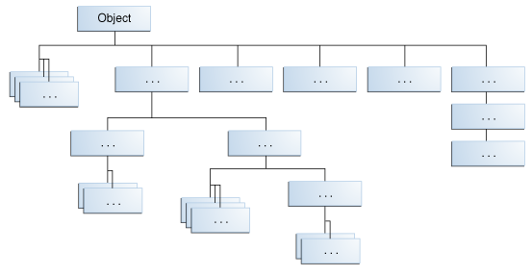
Java Platform Class Hierarchy
Object is at the root of Java Class Hierarchy

Slide 98
Inheritance in Java
Java supports inheritance through extends keyword
class Person { … }
class Student extends Person { … }
class Employee extends Person { … }
Student extends Person
Person
Student
Employee
Notes:
(c) 2006 National Academy for Software Development - http://academy.devbg.org*
98##

Slide 99
Inheritance – Derived Class
Class taking all members from another class
Person
Reusing Person
Mother : Person
Father : Person
Student
Employee
School: School
Org: Organization

Slide 100
Using Inherited Members
You can access inherited members
class Person { public void sleep() { … } }
class Student extends Person { … }
class Employee extends Person { … }
Student student = new Student();
student.sleep();
Employee employee = new Employee();
employee.sleep();
Notes:
(c) 2006 National Academy for Software Development - http://academy.devbg.org*
100##

Slide 101
Reusing Constructors
Constructors are not inherited
Constructors can be reused by the child classes
class Student extends Person {
private School school;
public Student(String name, School school) {
super(name);
this.school = school;
}
}
Constructor call should be first
Notes:
(c) 2006 National Academy for Software Development - http://academy.devbg.org*
101##

Slide 102
Thinking about Inheritance – Extends
A derived class instance contains an instance of its base class
Student (Derived Class)
+study():void
Employee (Derived Class)
+work():void
Person (Base Class)
+sleep():void

Slide 103
Inheritance
Inheritance has a transitive relation
class Person { … }
class Student extends Person { … }
class CollegeStudent extends Student { … }
Person
Student
CollegeStudent
Notes:
(c) 2006 National Academy for Software Development - http://academy.devbg.org*
103##

Slide 104
Multiple Inheritance
In Java there is no multiple inheritance
Only multiple interfaces can be implemented
Person
Student
CollegeStudent
Notes:
(c) 2006 National Academy for Software Development - http://academy.devbg.org*
104##

Slide 105
Access to Base Class Members
Use the super keyword
class Person { … }
class Employee extends Person {
public void fire(String reasons) {
System.out.println( super.name + " got fired because " + reasons);
}
}
Notes:
(c) 2006 National Academy for Software Development - http://academy.devbg.org*
105##

Slide 106
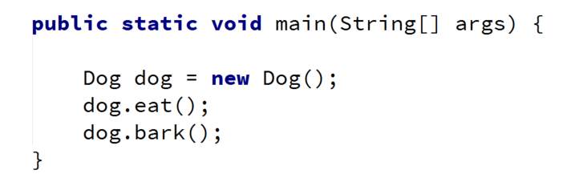
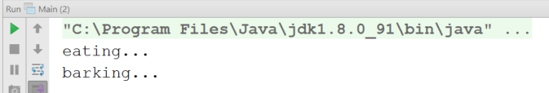
Problem: Single Inheritance
Animal
+eat():void
Dog
+bark():void
Check your solution here: https://judge.softuni.bg/Contests/1574/Inheritance-Lab
Notes:
(c) 2006 National Academy for Software Development - http://academy.devbg.org*
106##

Slide 107
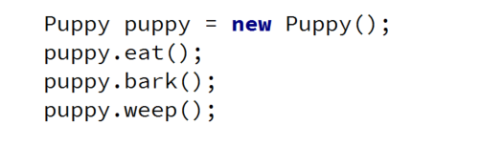
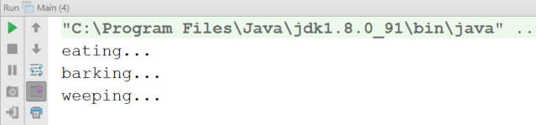
Problem: Multiple Inheritance
Animal
+eat():void
Dog
+bark():void
Puppy
+weep():void
Notes:
(c) 2006 National Academy for Software Development - http://academy.devbg.org*
107##

Slide 108
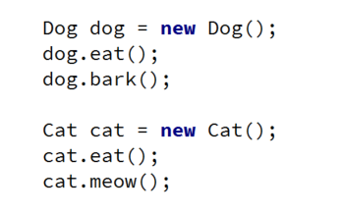
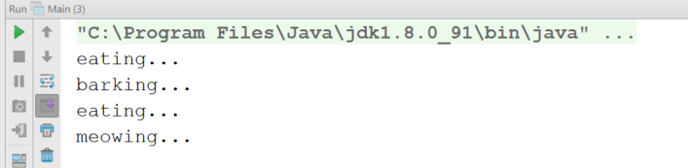
Problem: Hierarchical Inheritance
Animal
+eat():void
Dog
Cat
+bark():void
+meow():void
Notes:
(c) 2006 National Academy for Software Development - http://academy.devbg.org*
108##

Slide 109

Reusing Classes

Slide 110
Inheritance and Access Modifiers
Derived classes can access all public and protected members
Derived classes can access default members if in same package
Private fields aren't inherited in subclasses (can't be accesssed)
class Person {
protected String address;
public void sleep();
String name;
private String id;
}
Can be accessed through other methods
Notes:
(c) 2006 National Academy for Software Development - http://academy.devbg.org*
110##

Slide 111
Shadowing Variables
Derived classes can hide superclass variables
class Person { protected int weight; }
class Patient extends Person {
protected float weight;
public void method() {
double weight = 0.5d;
}
}
hides int weight
hides both
Notes:
(c) 2006 National Academy for Software Development - http://academy.devbg.org*
111##

Slide 112
Shadowing Variables – Access
Use super and this to specify member access
class Person { protected int weight; }
class Patient extends Person {
protected float weight;
public void method() {
double weight = 0.5d;
this.weight = 0.6f;
super.weight = 1;
}
}
Local variable
Instance member
Base class member
Notes:
(c) 2006 National Academy for Software Development - http://academy.devbg.org*
112##

Slide 113
Overriding Derived Methods
A child class can redefine existing methods
public class Person { public void sleep() {
System.out.println("Person sleeping"); }
}
public class Student extends Person {
@Override
public void sleep(){
System.out.println("Student sleeping"); }
}
Method in base class must not be final
Signature and return type should match
Notes:
Extensibility / Polymorphism: New functionality may be easily plugged in without changing existing classes as long the new plug-in classes extend given base classes.
Reusability: For a set of similar applications a framework can be defined using a core set of classes that are to be extended by classes that fill in the application-dependent part.
Information Hiding: If a more general class using a simpler contract is sufficient, details from extending classes may be hidden to some of the client classes. This allows them to be more independent from possible changes and diminishes the load of contracts that must be understood by a reader of these client classes.
(c) 2006 National Academy for Software Development - http://academy.devbg.org*
113##

Slide 114
Final Methods
final – defines a method that can't be overridden
public class Animal {
public final void eat() { … }
}
public class Dog extends Animal {
@Override
public void eat() {} // Error…
}
Notes:
(c) 2006 National Academy for Software Development - http://academy.devbg.org*
114##

Slide 115
Final Classes
Inheriting from a final classes is forbidden
public final class Animal {
…
}
public class Dog extends Animal { } // Error…
public class MyString extends String { } // Error…
public class MyMath extends Math { } // Error…
Notes:
(c) 2006 National Academy for Software Development - http://academy.devbg.org*
115##

Slide 116
Inheritance Benefits – Abstraction
One approach for providing abstraction
Focus on common properties
Person person = new Person();
Student student = new Student();
List<Person> people = new ArrayList();
people.add(person);
people.add(student);
Student (Derived Class)
Person (Base Class)
Notes:
(c) 2006 National Academy for Software Development - http://academy.devbg.org*
116##

Slide 117
Inheritance Benefits – Extension
We can extend a class that we can't otherwise change
Collections
ArrayList
Extends
CustomArrayList
Notes:
(c) 2006 National Academy for Software Development - http://academy.devbg.org*
117##

Slide 118
Problem: Random Array List
Create an array list that has
All functionality of an ArrayList
Function that returns and removes a random element
Collections
ArrayList
+getRandomElement():Object
RandomArrayList
Notes:
(c) 2006 National Academy for Software Development - http://academy.devbg.org*
118##

Slide 119
Solution: Random Array List
public class RandomArrayList extends ArrayList {
private Random rnd; // Initialize this…
public Object getRandomElement() {
int index = this.rnd.nextInt(super.size());
Object element = super.get(index);
super.remove(index);
return element;
}
}
Notes:
(c) 2006 National Academy for Software Development - http://academy.devbg.org*
119##

Slide 120

Types of Class Reuse

Slide 121
Extension
Duplicate code is error prone
Reuse classes through extension
Sometimes the only way
Collections
ArrayList
CustomArrayList

Slide 122
Composition
Using classes to define classes
Laptop
class Laptop {
Monitor monitor;
Touchpad touchpad;
Keyboard keyboard;
…
}
Monitor
Touchpad
Reusing classes
Keyboard

Slide 123
Delegation
class Laptop {
Monitor monitor;
void incrBrightness() {
monitor.brighten();
}
void decrBrightness() {
monitor.dim();
}
}
Laptop
increaseBrightness()
decreaseBrightness()
Monitor

Slide 124
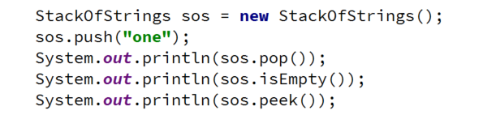
Problem: Stack of Strings
Create a simple Stack class which can store only strings
StackOfStrings
StackOfStrings
-data: List<String>
ArrayList
+push(String) :void
+pop(): String
+peek(): String
+isEmpty(): boolean
Notes:
(c) 2006 National Academy for Software Development - http://academy.devbg.org*
124##

Slide 125
Solution: Stack of Strings
public class StackOfStrings {
private List<String> container;
// TODO: Create a constructor
public void push(String item) { this.container.add(item); }
public String pop() {
// TODO: Validate if list is not empty
return this.container.remove(this.container.size() - 1);
}
}
Notes:
(c) 2006 National Academy for Software Development - http://academy.devbg.org*
125##

Slide 126
When to Use Inheritance
Classes share IS-A relationship
Derived class IS-A-SUBSTITUTE for the base class
Share the same role
Derived class is the same as the base class but adds a little bit more functionality
Too simplistic
Notes:
(c) 2006 National Academy for Software Development - http://academy.devbg.org*
126##

Slide 127
Summary
…
…
…
Inheritance is a powerful tool for code reuse
Subclass inherits members from Superclass
Subclass can override methods
Look for classes with the same role
Look for IS-A and IS-A-SUBSTITUTE for relationship
Consider Composition and Delegation instead

Slide 128
Questions?
Notes:
128

Slide 129
SoftUni Diamond Partners

Slide 130
Educational Partners

Slide 131
Trainings @ Software University (SoftUni)
Software University – High-Quality Education, Profession and Job for Software Developers
softuni.bg
Software University Foundation
softuni.foundation
Software University @ Facebook
facebook.com/SoftwareUniversity
Software University Forums
forum.softuni.bg
131
Notes:
131

Slide 132
License
This course (slides, examples, demos, exercises, homework, documents, videos and other assets) is copyrighted content
Unauthorized copy, reproduction or use is illegal
© SoftUni – https://about.softuni.bg
© Software University – https://softuni.bg
Notes:
132

Slide 133
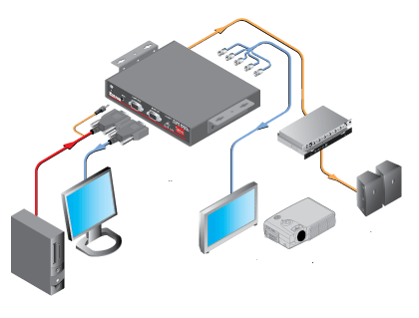
Interfaces and Abstraction
Interfaces vs Abstract Classes Abstraction vs Encapsulation
SoftUni Team
Technical Trainers
Software University
https://softuni.bg

Slide 134
Table of Contents
Abstraction
Abstraction vs Encapsulation
Interfaces
Default Methods
Static Methods
Abstract Classes
Interfaces vs Abstract Classes

Slide 135
Have a Question?
sli.do
#java-advanced

Slide 136

Abstraction

Slide 137
What is Abstraction?
Latin origin
Preserving information that is relevant in a context
Forgetting information that is irrelevant in that context
Abs
(away from)
Trahere
(to draw)
Abstraction
137

Slide 138

Abstraction in OOP
Abstraction means ignoring irrelevant features, properties, or functions and emphasizing the relevant ones …
... relevant to the context of the project we develop
Abstraction helps managing complexity
Abstraction lets you focus on what the object does instead of how it does it
"Relevant" to what?
138

Slide 139
Achieving Abstraction
There are 2 ways to achieve abstraction in Java
Interfaces (100% abstraction)
Abstract class (0% - 100% abstraction)
public interface Animal {}
public abstract class Mammal {}
public class Person extends Mammal implements Animal {}
Notes:
There are two ways to achieve abstraction
- Using Abstract Classes
- Using Interfaces

Slide 140
Abstraction vs. Encapsulation
Abstraction
Process of hiding the implementation details and showing only functionality to the user
Achieved with interfaces and abstract classes
Encapsulation
Used to hide the code and data inside a single unit to protect the data from the outside world
Achieved with access modifiers (private, protected, public)
140

Slide 141

Interfaces

Slide 142
Interface
Internal addition by compiler
Keyword
public interface Printable {
int MIN = 5;
void print();
}
Public or default modifier
Name
compiler
"public static final" before fields
interface Printable {
public static final int MIN = 5;
public abstract void print();
}
"public abstract" before methods
Notes:
There are two ways to achieve abstraction
- Using Abstract Classes
- Using Interfaces

Slide 143
Implements vs Extends
Relationship between classes and interfaces
Multiple inheritance
Class
Interface
Interface
extends
implements
extends
Class
Class
Interface
Interface
Interface
Interface
Interface
implements
extends
Class
Interface
Notes:
There are two ways to achieve abstraction
- Using Abstract Classes
- Using Interfaces

Slide 144
Interface Example
Implementation of print() is provided in class Document
public interface Printable {
void print();
}
class Document implements Printable {
public void print() { System.out.println("Hello"); }
public static void main(String args[]) {
Printable doc = new Document();
doc.print(); // Hello
}
}
Polymorphism
Notes:
There are two ways to achieve abstraction
- Using Abstract Classes
- Using Interfaces

Slide 145

Problem: Car Shop
Serializable
Seat
-countryProduced: String
<<interface>>
<<Car>>
+toString(): String
+TIRES: Integer
+getModel(): String
+getColor(): String
+getHorsePower(): Integer
Check your solution here: https://judge.softuni.bg/Contests/1581/Interfaces-and-Abstraction-Lab
Notes:
There are two ways to achieve abstraction
- Using Abstract Classes
- Using Interfaces

Slide 146
Solution: Car Shop (1)
public interface Car {
int TIRES = 4;
String getModel();
String getColor();
Integer getHorsePower();
String countryProduced();
}
Notes:
There are two ways to achieve abstraction
- Using Abstract Classes
- Using Interfaces

Slide 147
Solution: Car Shop (2)
public class Seat implements Car, Serializable {
// TODO: Add fields, constructor and private methods
@Override
public String getModel() { return this.model; }
@Override
public String getColor() { return this.color; }
@Override
public Integer getHorsePower() { return this.horsePower; }
}
Notes:
There are two ways to achieve abstraction
- Using Abstract Classes
- Using Interfaces

Slide 148
Extend Interface
Interface can extend another interface
public interface Showable {
void show();
}
public interface Printable extends Showable {
void print();
}
Notes:
There are two ways to achieve abstraction
- Using Abstract Classes
- Using Interfaces

Slide 149
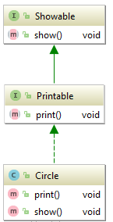
Extend Interface
Class which implements child interface must provide implementation for parent interface too
class Circle implements Printable
public void print() {
System.out.println("Hello");
}
public void show() {
System.out.println("Welcome");
}
Notes:
There are two ways to achieve abstraction
- Using Abstract Classes
- Using Interfaces

Slide 150
Problem: Car Shop Extended
Refactor your first problem code
Add for rentable cars
Add class Cinterface for sellable cars
Add interface arImpl
Add class Audi, which extends CarImpl and implements rentable
Refactor class Seat to extends CarImpl and implements rentable
Notes:
There are two ways to achieve abstraction
- Using Abstract Classes
- Using Interfaces

Slide 151
Solution: Car Shop Extended (1)
public interface Sellable extends Car {
Double getPrice();
}
public interface Rentable extends Car {
Integer getMinRentDay();
Double getPricePerDay();
}
Notes:
There are two ways to achieve abstraction
- Using Abstract Classes
- Using Interfaces

Slide 152
Solution: Car Shop Extended (2)
public class Audi extends CarImpl implements Rentable {
public Integer getMinRentDay() {
return this.minDaysForRent; }
public Double getPricePerDay() {
return this.pricePerDay; }
// TODO: Add fields, toString() and Constructor
}
Notes:
There are two ways to achieve abstraction
- Using Abstract Classes
- Using Interfaces

Slide 153
Default Method
Since Java 8 we can have method body in the interface
If you need to override default method think about your design
public interface Drawable {
void draw();
default void msg() {
System.out.println("default method:");
}
}
Notes:
There are two ways to achieve abstraction
- Using Abstract Classes
- Using Interfaces

Slide 154
Default Method
Implementation is not needed for default methods
class TestInterfaceDefault {
public static void main(String args[]) {
Drawable d = new Rectangle();
d.draw(); // drawing rectangle
d.msg(); // default method
}
}
Notes:
There are two ways to achieve abstraction
- Using Abstract Classes
- Using Interfaces

Slide 155
Static Method
Since Java 11, we can have static method in interface
public interface Drawable {
void draw();
static int cube(int x) { return x*x*x; }
}
public static void main(String args[]) {
Drawable d = new Rectangle();
d.draw();
System.out.println(Drawable.cube(3)); } // 27
Notes:
There are two ways to achieve abstraction
- Using Abstract Classes
- Using Interfaces

Slide 156
Problem: Say Hello
Design a project, which has
Interface for Person
3 implementations for different nationalities
Override where needed
<<interface>>
<<Person>>
+getName(): String
+sayHello():String
<<Person>>
Bulgarian
<<Person>>
European
<<Person>>
Chinese
-name: String
-name: String
-name: String
+sayHello(): String
+sayHello(): String
Notes:
There are two ways to achieve abstraction
- Using Abstract Classes
- Using Interfaces

Slide 157
Solution: Say Hello (1)
public interface Person {
String getName();
default String sayHello() { return "Hello"; }
}
public class European implements Person {
private String name;
public European(String name) { this.name = name; }
public String getName() { return this.name; }
}
Notes:
There are two ways to achieve abstraction
- Using Abstract Classes
- Using Interfaces

Slide 158
Solution: Say Hello (2)
public class Bulgarian implements Person {
private String name;
public Bulgarian(String name) {
this.name = name;
}
public String getName() { return this.name; }
public String sayHello() { return "Здравей"; }
}
// TODO: implement class Chinese
Notes:
There are two ways to achieve abstraction
- Using Abstract Classes
- Using Interfaces

Slide 159

Abstract Classes

Slide 160
Abstract Class
Cannot be instantiated
May contain abstract methods
Must provide implementation for all inherited interface members
Implementing an interface might map the interface methods onto abstract methods
public abstract class Animal {
}
160
Notes:
There are two ways to achieve abstraction
- Using Abstract Classes
- Using Interfaces

Slide 161
Abstract Methods
Declarations are only permitted in abstract classes
Bodies must be empty (no curly braces)
An abstract method declaration provides no actual implementation:
public abstract void build();
161

Slide 162

Interfaces vs Abstract Classes

Slide 163
Interface vs Abstract Class (1)
Interface
A class may implement several interfaces
Cannot have access modifiers, everything is assumed as public
Abstract Class (AC)
May inherit only one abstract class
Provides implementation and/or just the signature that has to be overridden
Can contain access modifiers for the fields, functions, properties
163

Slide 164
Interface vs Abstract Class (2)
Interface
If we add a new method we must track down all the implementations of the interface and define implementation for the new method
Abstract Class
Fields and constants can be defined
If we add a new method we have the option of providing default implementation
164

Slide 165
Problem: Say Hello Extended
Refactor the code from the last problem
Add BasePerson abstract class
In which move all code duplication from European, Bulgarian, Chinese
BasePerson
-name: String
#BasePerson(name)
-setName(): void
Notes:
Java interfaces are like purely abstract classes, but:
- All interface methods are abstract
- Interface members do not have scope modifiers
- Their scope is assumed public
- But public is not specified explicitly
- Cannot define fields, inner types and constructors

Slide 166
Solution: Say Hello Extended
public abstract class BasePerson implements Person {
private String name;
protected BasePerson(String name) {
this.setName(name);
}
private void setName(String name) { this.name = name; }
@Override
public String getName() {
return this.name;
}
}
Notes:
There are two ways to achieve abstraction
- Using Abstract Classes
- Using Interfaces

Slide 167
Summary
…
…
…
Abstraction – hiding implementation and showing functionality
Interfaces
implements vs extends
Default and Static methods
Abstract classes
Interfaces vs Abstract Classes

Slide 168
Questions?
Notes:
168

Slide 169
SoftUni Diamond Partners

Slide 170
Educational Partners

Slide 171
Trainings @ Software University (SoftUni)
Software University – High-Quality Education, Profession and Job for Software Developers
softuni.bg
Software University Foundation
softuni.foundation
Software University @ Facebook
facebook.com/SoftwareUniversity
Software University Forums
forum.softuni.bg
171
Notes:
171

Slide 172
License
This course (slides, examples, demos, exercises, homework, documents, videos and other assets) is copyrighted content
Unauthorized copy, reproduction or use is illegal
© SoftUni – https://about.softuni.bg
© Software University – https://softuni.bg
Notes:
172

Slide 173
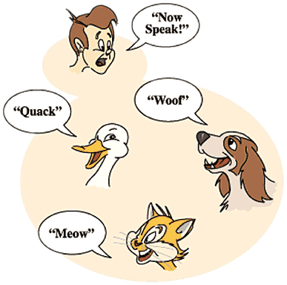
Polymorphism
Abstract Classes, Abstract Methods, Override Methods
SoftUni Team
Technical Trainers
Software University
https://softuni.bg

Slide 174
Table of Contents
Polymorphism
What is Polymorphism?
Types of Polymorphism
Override Methods
Overload Methods
Abstract Classes
Abstract Methods

Slide 175
Have a Question?
sli.do
#java-advanced

Slide 176
Polymorphism

Slide 177
What is Polymorphism?
From the Greek
Such as a word having several different meanings based on the context
Often referred to as the third pillar of OOP, after encapsulation and inheritance
Polys
(many)
Morphe
(shape/forms)
Polymorphos
177
Notes:
Polymorphism is the ability of an object to take on many forms. The most common use of polymorphism in OOP occurs when a parent class reference is used to refer to a child class object.

Slide 178
Polymorphism in OOP
Ability of an object to take on many forms
public interface Animal {}
public abstract class Mammal {}
public class Person extends Mammal implements Animal {}
Person IS-A Person
Person IS-AN Animal
Person IS-A Mammal
Person IS-AN Object

Slide 179
Reference Type and Object Type
public class Person extends Mammal implements Animal {}
Animal person = new Person();
Mammal personOne = new Person();
Person personTwo = new Person();
Reference Type
Object Type
Variables are saved in reference type
You can use only reference methods
If you need object method you need to cast it or override it

Slide 180
Keyword – Instanceof
Check if object is an instance of a specific class
Mammal george = new Person();
Person peter = new Person();
Check object type of person
if (george instanceof Person) {
((Person) george).getSalary();
}
if (peter.getClass() == Person.class) {
((Person) peter).getSalary();
}
Cast to object type and use its methods

Slide 181
Types of Polymorphism
Runtime polymorphism
Compile time polymorphism
public class Shape {}
public class Circle extends Shape {}
public static void main(String[] args) {
Shape shape = new Circle();
}
Method overriding
int sum(int a, int b, int c){}
double sum(Double a, Double b){}
Method overloading

Slide 182
Compile Time Polymorphism
Also known as Static Polymorphism
Argument lists could differ in
Number of parameters
Data type of parameters
Sequence of Data type of parameters
static int myMethod(int a, int b) {}
static Double myMethod(Double a, Double b) {}
Method overloading

Slide 183
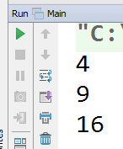
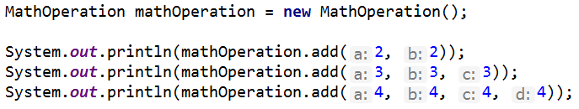
Problem: MathOperation
Create a class MathOperation, which should have method add()
Must be invoked with two, three or four integers
MathOperation
+add(int a, int b): int
+add(int a, int b, int c): int
+add(int a, int b, int c, int d): int
Check your solution here: https://judge.softuni.bg/Contests/1592/Polymorphism-Lab
Notes:
Extensibility / Polymorphism: New functionality may be easily plugged in without changing existing classes as long the new plug-in classes extend given base classes.
Reusability: For a set of similar applications a framework can be defined using a core set of classes that are to be extended by classes that fill in the application-dependent part.
Information Hiding: If a more general class using a simpler contract is sufficient, details from extending classes may be hidden to some of the client classes. This allows them to be more independent from possible changes and diminishes the load of contracts that must be understood by a reader of these client classes.
(c) 2006 National Academy for Software Development - http://academy.devbg.org*
183##

Slide 184
Solution: MathOperation
public class MathOperation {
public int add(int a, int b) {
return a + b;
}
public int add(int a, int b, int c) {
return a + b + c;
}
public int add(int a, int b, int c, int d) {
return a + b + c + d;
}
}
Notes:
Extensibility / Polymorphism: New functionality may be easily plugged in without changing existing classes as long the new plug-in classes extend given base classes.
Reusability: For a set of similar applications a framework can be defined using a core set of classes that are to be extended by classes that fill in the application-dependent part.
Information Hiding: If a more general class using a simpler contract is sufficient, details from extending classes may be hidden to some of the client classes. This allows them to be more independent from possible changes and diminishes the load of contracts that must be understood by a reader of these client classes.
(c) 2006 National Academy for Software Development - http://academy.devbg.org*
184##

Slide 185
Rules for Overloading Method
Overloading can take place in the same class or in its sub-class
Constructors in Java can be overloaded
Overloaded methods must have a different argument list
Overloaded method should always be the part of the same class (can also take place in sub class), with same name but different parameters
They may have the same or different return types
Notes:
To pass more specific object to method

Slide 186
Runtime Polymorphism
Using of override method
public static void main(String[] args) {
Rectangle rect = new Rectangle(3.0, 4.0);
Rectangle square = new Square(4.0);
System.out.println(rect.area());
System.out.println(square.area());
}
Method overriding

Slide 187
Runtime Polymorphism
Also known as Dynamic Polymorphism
public class Rectangle {
public Double area() {
return this.a * this.b;
}
}
public class Square extends Rectangle {
@Override
public Double area() {
return this.a * this.a;
}
}
Method overriding
Notes:
Demo (look at View -> Notes Page)
public static void main(String[] args) {
Vegetarian babyDeer = new Deer();
Vegetarian babyElephant = new Elephant();
List<Vegetarian> vegetarianAnimals = new ArrayList<>();
vegetarianAnimals.add(babyDeer);
vegetarianAnimals.add(babyElephant);
}

Slide 188
Rules for Overriding Method
Overriding can take place in sub-class
Argument list must be the same as that of the parent method
The overriding method must have same return type
Access modifier cannot be more restrictive
Private, static and final methods can NOT be overriden
The overriding method must not throw new or broader checked exceptions
Notes:
To pass more specific object to method

Slide 189
Abstract Classes
Shape
Circle
Rectangle

Slide 190
Abstract Classes
Abstract class can NOT be instantiated
An abstract class may or may not include abstract methods
If it has at least one abstract method, it must be declared abstract
To use an abstract class, you need to inherit it
public abstract class Shape {}
public class Circle extends Shape {}
Shape shape = new Shape(); // Compile time error
Shape circle = new Circle(); // polymorphism
190

Slide 191
Problem: Shapes
Shape
-Double perimeter
-Double area
Encapsulate area
+getPerimeter()
#setPerimeter(Double perimeter)
+calculatePerimeter
+calculateArea
Rectangle
Circle
-Double height
-Double width
-Double radius
+calculatePerimeter
+calculateArea
+calculatePerimeter
+calculateArea
Notes:
Extensibility / Polymorphism: New functionality may be easily plugged in without changing existing classes as long the new plug-in classes extend given base classes.
Reusability: For a set of similar applications a framework can be defined using a core set of classes that are to be extended by classes that fill in the application-dependent part.
Information Hiding: If a more general class using a simpler contract is sufficient, details from extending classes may be hidden to some of the client classes. This allows them to be more independent from possible changes and diminishes the load of contracts that must be understood by a reader of these client classes.
(c) 2006 National Academy for Software Development - http://academy.devbg.org*
191##

Slide 192
Solution: Shapes (1)
public abstract class Shape {
private Double perimeter;
private Double area;
protected void setPerimeter(Double perimeter) {
this.perimeter = perimeter;
}
public Double getPerimeter() { return this.perimeter; }
protected void setArea(Double area) {this.area = area; }
public Double getArea() { return this.area; }
protected abstract void calculatePerimeter();
protected abstract void calculateArea();
}
Notes:
Extensibility / Polymorphism: New functionality may be easily plugged in without changing existing classes as long the new plug-in classes extend given base classes.
Reusability: For a set of similar applications a framework can be defined using a core set of classes that are to be extended by classes that fill in the application-dependent part.
Information Hiding: If a more general class using a simpler contract is sufficient, details from extending classes may be hidden to some of the client classes. This allows them to be more independent from possible changes and diminishes the load of contracts that must be understood by a reader of these client classes.
(c) 2006 National Academy for Software Development - http://academy.devbg.org*
192##

Slide 193
Solution: Shapes (2)
public class Rectangle extends Shape {
//TODO: Add fields
public Rectangle(Double height, Double width) {
this.setHeight(height); this.setWidth(width);
this.calculatePerimeter(); this.calculateArea(); }
//TODO: Add getters and setters
@Override
protected void calculatePerimeter() {
setPerimeter(this.height * 2 + this.width * 2); }
@Override
protected void calculateArea() {
setArea(this.height * this.width); } }
Notes:
Extensibility / Polymorphism: New functionality may be easily plugged in without changing existing classes as long the new plug-in classes extend given base classes.
Reusability: For a set of similar applications a framework can be defined using a core set of classes that are to be extended by classes that fill in the application-dependent part.
Information Hiding: If a more general class using a simpler contract is sufficient, details from extending classes may be hidden to some of the client classes. This allows them to be more independent from possible changes and diminishes the load of contracts that must be understood by a reader of these client classes.
(c) 2006 National Academy for Software Development - http://academy.devbg.org*
193##

Slide 194
Solution: Shapes (3)
public class Circle extends Shape {
private Double radius;
public Circle (Double radius) {
this.setRadius(radius);
this.calculatePerimeter();
this.calculateArea();
}
public final Double getRadius() {
return radius;
}
//TODO: Finish encapsulation
//TODO: Override calculate Area and Perimeter
}
Notes:
Extensibility / Polymorphism: New functionality may be easily plugged in without changing existing classes as long the new plug-in classes extend given base classes.
Reusability: For a set of similar applications a framework can be defined using a core set of classes that are to be extended by classes that fill in the application-dependent part.
Information Hiding: If a more general class using a simpler contract is sufficient, details from extending classes may be hidden to some of the client classes. This allows them to be more independent from possible changes and diminishes the load of contracts that must be understood by a reader of these client classes.
(c) 2006 National Academy for Software Development - http://academy.devbg.org*
194##

Slide 195
Summary
Polymorphism - Definition and Types
Override Methods
Overload Methods
Abstraction
Classes
Methods
…
…
…

Slide 196
Questions?
Notes:
196

Slide 197
SoftUni Diamond Partners

Slide 198
Educational Partners

Slide 199
Trainings @ Software University (SoftUni)
Software University – High-Quality Education, Profession and Job for Software Developers
softuni.bg
Software University Foundation
softuni.foundation
Software University @ Facebook
facebook.com/SoftwareUniversity
Software University Forums
forum.softuni.bg
199
Notes:
199

Slide 200
License
This course (slides, examples, demos, exercises, homework, documents, videos and other assets) is copyrighted content
Unauthorized copy, reproduction or use is illegal
© SoftUni – https://about.softuni.bg
© Software University – https://softuni.bg
Notes:
200

Slide 201
S.O.L.I.D.
The Benefits and Potential of Using SOLID Principles
S
Single Responsibility
O
Open/Closed
L
Liskov substitution
I
Interface Segregation
D
Dependency Inversion
SoftUni Team
Technical Trainers
Software University
https://softuni.bg

Slide 202
Table of Contents
S.O.L.I.D. Principles
Single Responsibility
Open / Closed
Liskov Substitution
Interface Segregation
Dependency Inversion

Slide 203
Have a Question?
sli.do
#java-advanced

Slide 204
SOLID Principles
SOLID

Slide 205
S.O.L.I.D.
S – Single responsibility principle – class should only have one responsibility
O – Open–closed principle – open for extension, but closed for modification
L – Liskov substitution principle – objects should be replaceable with instances of their subtypes without altering the correctness of that program

Slide 206
S.O.L.I.D.
I – Interface segregation principle – many specific interfaces are better than one general interface
D – Dependency inversion principle – one should depend upon abstractions, not concretions

Slide 207


Single Responsibility

Slide 208
Single Responsibility Principle
A class should have only one responsibility
Reduces dependency complexity
Each additional responsibility is an axis to change the class
public class HeroSettings {
public static void changeName(Hero hero) {
// Grant option to change
}
}
208

Slide 209
Single Responsibility Principle
Still classes can have multiple methods
Each method should have single functionality part of the class responsibility
public class HeroSettings {
public static void changeName(Hero hero) {
// Grant option to change name
}
public static void selectRole(Hero hero) {
// Grant option to select role
}
}
209

Slide 210


Open / Closed

Slide 211
What is Open/Closed?
Software entities (classes, modules, functions, etc.) should be
open for extension
closed for modification
Design the code in a way that new functionality can be added with minimum changes in the existing code
211

Slide 212

Extensibility
Implementation takes future growth into consideration
New or modified functionality affects little or not at all the internal structure and data flow of the system

Slide 213

Reusability
Software reusability refers to design features of a software element that enhance its suitability for reuse
Modularity
Low coupling
High cohesion
Coupling and Cohesion

Slide 214

OCP – Violations
Cascading changes through modules
Each change requires re-testing
Logic depends on conditional statements

Slide 215

OCP – Solutions
Inheritance / Abstraction
Inheritance / Template Method pattern
Composition / Strategy patterns

Slide 216

Liskov Substitution

Slide 217
What is Liskov Substitution?
Derived types must be completely substitutable for their base types
Reference to the base class can be replaced with a derived class without affecting the functionality of the program module
Derived classes extend without replacing the functionality of old classes
217

Slide 218
LSP Relationship
OOP Inheritance
Plus LSP
Student IS-A Person
Student IS-SUBSTITUTED-FOR Person

Slide 219
OCP vs LSP
Liskov Substitution Principle is just an extension of the Open Closed Principle
We must make sure that new derived classes are extending the base classes without changing their behavior
219

Slide 220
LSP – Violations and Solutions
Violations
Type Checking
Overridden methods say "I am not implemented"
Base class depends on its subtypes
Solutions
Refactoring in the base class

Slide 221
Interface Segregation

Slide 222
ISP – Interface Segregation Principle
Clients should not be forced to depend on methods they do not use
Segregate interfaces
Prefer small, cohesive interfaces
Divide "fat" interfaces into "role" interfaces

Slide 223
Fat Interfaces
Classes whose interfaces are not cohesive have "fat" interfaces
public interface Worker {
void work();
void sleep();
}
Class Employee is OK
public class Robot implements Worker {
public void work() {}
public void sleep() {
throw new UnsupportedOperationException();
}
}

Slide 224
"Fat" Interfaces
Having "fat" interfaces:
Classes have methods they do not use
Increased coupling
Reduced flexibility
Reduced maintainability

Slide 225
How to ISP?
Solutions to broken ISP
Small interfaces
Cohesive interfaces
Let the client define interfaces – "role" interfaces

Slide 226
Cohesive Interfaces
Small and Cohesive "Role" Interfaces
public interface Worker {
void work();
}
public interface Sleeper {
void sleep();
}
public class Robot implements Worker {
void work() {
// Do some work…
}
}

Slide 227

Dependency Inversion

Slide 228
Dependency Inversion Principle (DIP)
High-level modules should not depend on low-level modules
Both should depend on abstractions
Abstractions should not depend on details
Details should depend on abstractions
Goal: decoupling between modules through abstractions

Slide 229
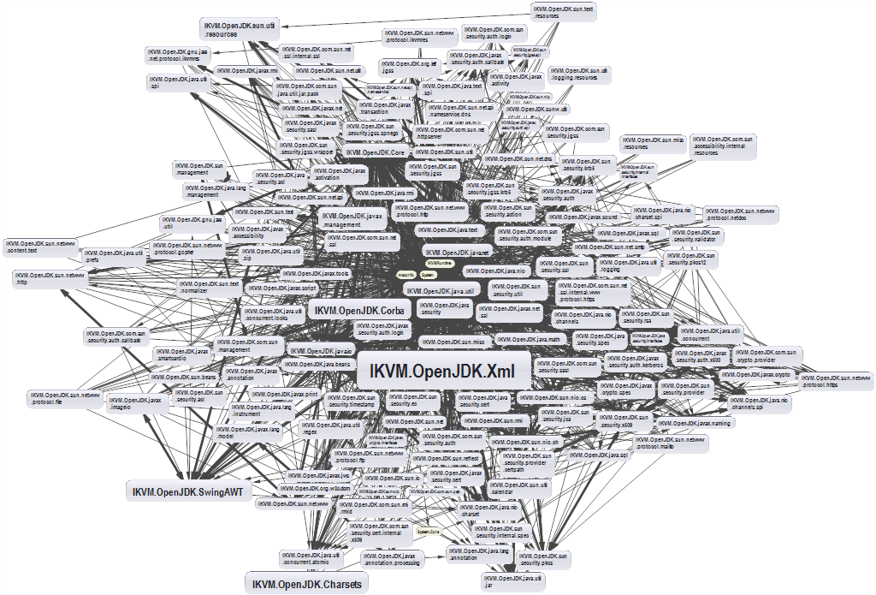
Dependencies and Coupling (1)
What happens when modules depend directly on other modules

Slide 230
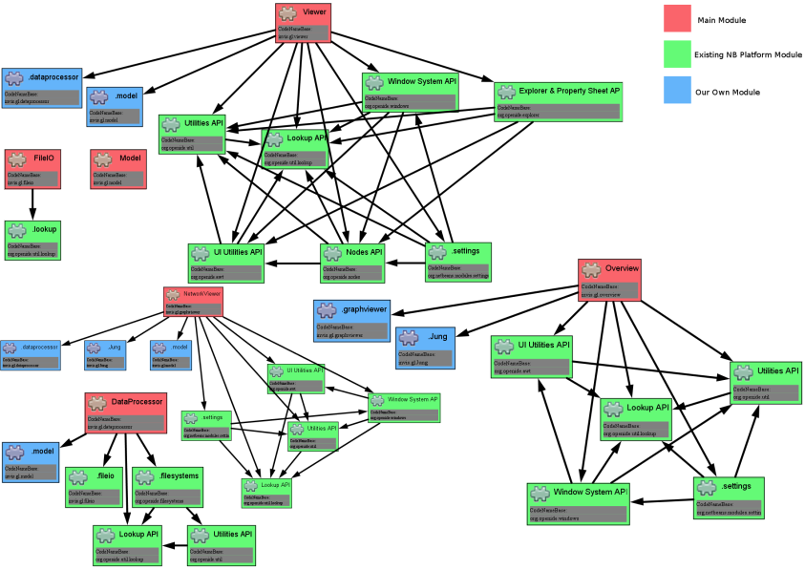
Dependencies and Coupling (2)
The goal is to depend on abstractions

Slide 231
The Problem
Button → Lamp Example – Robert Martin
Button depends on Lamp
High-level / Client
Lamp
turnOn()
turnOff()
Button
poll()
Low-level / Server

Slide 232
Dependency Inversion Solution
Find the abstraction independent of details
SwitchableDevice
<interface>
turnOn()
turnOff()
Button
poll()
uses
Client defines interfaces
implements
Lamp

Slide 233
Dependency Examples
A dependency is any external component / system:
Framework
Third party library
Database
File system
Email
Web service
System resource (e.g. clock)
Configuration
The new keyword
Static method
Global function
Random generator
System.in / System.out

Slide 234

How to DIP? (1)
Constructor injection - dependencies are passed through constructors
Pros
Classes self-documenting requirements
Works well without container
Always valid state
Cons
Many parameters
Some methods may not need everything

Slide 235
Constructor Injection – Example
public class Copy {
private Reader reader;
private Writer writer;
public Copy(Reader reader, Writer writer) {
this.reader = reader;
this.writer = writer;
}
public void copyAll() {}
}

Slide 236
How to DIP? (2)
Setter Injection - dependencies are passed through setters
Pros
Can be changed anytime
Very flexible
Cons
Possible invalid state of the object
Less intuitive

Slide 237
Setter Injection – Example
public class Copy {
private Reader reader;
private Writer writer;
public void setReader(Reader reader) {}
public void setWriter(Writer writer) {}
public void copyAll() {}
}

Slide 238
How to DIP? (3)
Parameter injection - dependencies are passed through method parameters
Pros
No change in rest of the class
Very flexible
Cons
Many parameters
Breaks the method signature
public class Copy {
public void copyAll(Reader reader, Writer writer) {}
}

Slide 239
Layering (1)
Traditional programming
High-level modules use low-level modules
UI Layer
UI Layer
Business Layer
Business Layer
Data Access Layer
Data Access Layer

Slide 240
Layering (2)
Dependency Inversion Layering
High and low-level modules depend on abstractions
Client defines interfaces
UI Layer
<BL Interface>
Business Layer
<DAL Interface>
Data Access Layer

Slide 241
Problem: Employee Info
You are given some classes
Refactor the code so that it conforms to DIP
Main
ConsoleFormatter
EmployeeInfoProvider
EmployeeDatabase

Slide 242
Solution: Employee Info
ConsoleClient
<Formatter>
<InfoProvider>
ConsoleFormatter
EmployeeInfoProvider
<Database>
EmployeeDatabase

Slide 243
Summary
…
…
…
SOLID principles make the software:
Understandable
Flexible
Maintainable

Slide 244
Questions?
Notes:
244

Slide 245
SoftUni Diamond Partners

Slide 246
Educational Partners

Slide 247
Trainings @ Software University (SoftUni)
Software University – High-Quality Education, Profession and Job for Software Developers
softuni.bg
Software University Foundation
softuni.foundation
Software University @ Facebook
facebook.com/SoftwareUniversity
Software University Forums
forum.softuni.bg
247
Notes:
247

Slide 248
License
This course (slides, examples, demos, exercises, homework, documents, videos and other assets) is copyrighted content
Unauthorized copy, reproduction or use is illegal
© SoftUni – https://about.softuni.bg
© Software University – https://softuni.bg
Notes:
248

Slide 249

Reflection and Annotations
SoftUni Team
Technical Trainers
Software University
https://softuni.bg

Slide 250
Table of Contents
Reflection - What? Why? Where?
Reflection API
Reflecting Classes
Reflecting Constructors
Reflecting Fields
Reflecting Methods
Access Modifiers
Reflecting Annotations

Slide 251
Have a Question?
sli.do
#java-advanced

Slide 252

Reflection

Slide 253
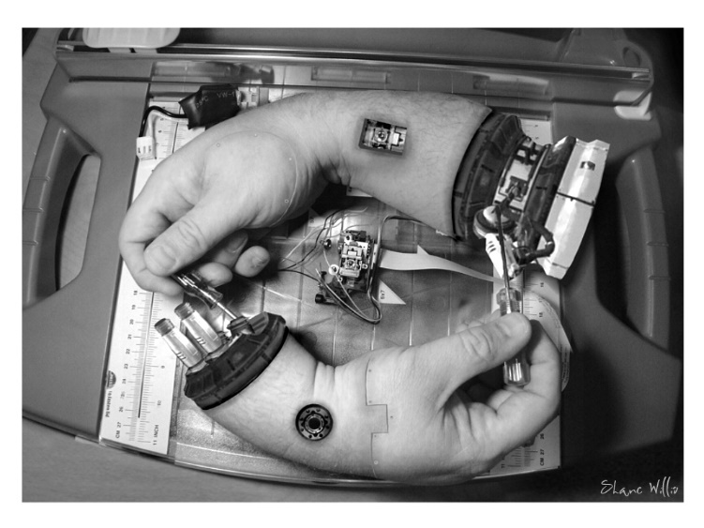
What is Metaprogramming?
Programming technique in which computer programs have the ability to treat programs as their data
Program can be designed to:
Read
Generate
Analyze
Transform
Modify itself while running

Slide 254

What is Reflection?
The ability of a programming language to be its own metalanguage
Programs can examine information about themselves
254

Slide 255
When to Use Reflection?
?
Whenever we want:
Code to become more extendible
To reduce code length significantly
Easier maintenance
Easier testing
255

Slide 256

When Not to Use Reflection?
If it is possible to perform an operation without using reflection, then it is preferable to avoid using it
Cons from using Reflection
Performance overhead
Security restrictions
Exposure of internal logic

Slide 257

Reflection API

Slide 258
The Class Object
Оbtain its java.lang.Class object
If you know the name
If you don't know the name at compile time
Class myObjectClass = MyObject.class;
Class myClass = Class.forName(className);
You need fully qualified class name as String

Slide 259
Class Name
Obtain Class name
Fully qualified class name
Class name without the package name
String className = aClass.getName();
String simpleClassName = aClass.getSimpleName();

Slide 260
Base Class and Interfaces
Obtain parent class
Obtain interfaces
Interfaces are also represented by Class objects in Java Reflection
Only the interfaces specifically declared implemented by a given class are returned
Class className = aClass.getSuperclass();
Class[] interfaces = aClass.getInterfaces();

Slide 261
Problem: Reflection
Import ReflectionClass to your src folder in your project
Using reflection you should print:
This class type
Super class type
All Interfaces
Instantiate object using reflection and print it
Don't change anything in class
Check your solution here: https://judge.softuni.bg/Contests/1604/Reflection-Lab

Slide 262
Solution: Reflection
Class<Reflection> aClass = Reflection.class;
System.out.println(aClass);
System.out.println(aClass.getSuperclass());
Class[] interfaces = aClass.getInterfaces();
for (Class anInterface : interfaces)
System.out.println(anInterface);
//Reflection ref = aClass.newInstance();//Deprecated since Java 9
Reflection ref = aClass.getDeclaredConstructor().newInstance();
System.out.println(ref);
Create new object
Notes:
There are two ways to achieve abstraction
- Using Abstract Classes
- Using Interfaces

Slide 263

Constructors, Fields and Methods

Slide 264
Constructors (1)
Obtain only public constructors
Obtain all constructors
Get constructor by parameters
Constructor[] ctors = aClass.getConstructors();
Constructor[] ctors =
aClass.getDeclaredConstructors();
Constructor ctor =
aClass.getConstructor(String.class);

Slide 265
Constructors (2)
Get parameter types
Instantiating objects using constructor
Class[] parameterTypes =
ctor.getParameterTypes();
Constructor constructor = MyObject.class.getConstructor(String.class);
MyObject myObject = (MyObject)constructor
.newInstance("arg1");

Slide 266
Fields Name and Type
Obtain public fields
Obtain all fields
Get field name and type
Field field = aClass.getField("somefield");
Field[] fields = aClass.getFields();
Field[] fields = aClass.getDeclaredFields();
String fieldName = field.getName();
Object fieldType = field.getType();

Slide 267
Fields Set and Get
Setting value for field
Class aClass = MyObject.class;
Field field = aClass.getDeclaredField("someField");
MyObject objectInstance = new MyObject();
field.setAccessible(true);
Object value = field.get(objectInstance);
field.set(objectInstance, value);
Change the behavior of the AccessibleObject
The objectInstance parameter passed to the get and set method should be an instance of the class that owns the field

Slide 268
Methods
Obtain public methods
Get methods without parameters
Method[] methods = aClass.getMethods();
Method method =
aClass.getMethod("doSomething",String.class);
Method method =
aClass.getMethod("doSomething", null);

Slide 269
Method Invoke
Obtain method parameters and return type
Get methods with parameters
Class[] paramTypes = method.getParameterTypes();
Class returnType = method.getReturnType();
Method method = MyObject.class
.getMethod("doSomething", String.class);
Object returnValue = method.invoke(null, "arg1");
null is for static methods

Slide 270
Problem: Getters and Setters
Using reflection get all methods and print:
Sort getters and setters alphabetically
Getters:
A getter method have its name start with "get", take 0 parameters, and returns a value
Setters:
A setter method have its name start with "set", and takes 1 parameter
Check your solution here: https://judge.softuni.bg/Contests/1604/Reflection-Lab

Slide 271
Solution: Getters
Method[] methods = Reflection.class.getDeclaredMethods();
Method[] getters = Arrays.stream(methods)
.filter(m -> m.getName().startsWith("get") &&
m.getParameterCount() == 0)
.sorted(Comparator.comparing(Method::getName))
.toArray(Method[]::new);
Arrays.stream(getters).forEach(m ->
System.out.printf("%s will return class %s%n",
m.getName(), m.getReturnType().getName()));
Notes:
There are two ways to achieve abstraction
- Using Abstract Classes
- Using Interfaces

Slide 272
Access Modifiers

Slide 273
Access Modifiers
Obtain the class modifiers like this
Еach modifier is a flag bit that is either set or cleared
You can check the modifiers
int modifiers = aClass.getModifiers();
getModifiers() can be called on constructors, fields, methods
Modifier.isPrivate(modifiers);
Modifier.isProtected(modifiers);
Modifier.isPublic(modifiers);
Modifier.isStatic(modifiers);
Notes:
There are two ways to achieve abstraction
- Using Abstract Classes
- Using Interfaces

Slide 274
Arrays
Creating arrays via Java Reflection
Obtain parameter annotations
Obtain fields and methods annotations
int[] intArray = (int[]) Array.newInstance(int.class, 3);
Array.set(intArray, 0, 123);
Array.set(intArray, 1, 456);
Class stringArrayComponentType =
stringArrayClass.getComponentType();
Notes:
There are two ways to achieve abstraction
- Using Abstract Classes
- Using Interfaces

Slide 275
Problem: High Quality Mistakes
You perfectly know how to write High Quality Code
Check Reflection class and print all mistakes in access modifiers which you can find
Get all fields, getters and setters and sort each category by name
First print mistakes in fields
Then print mistakes in getters
Then print mistakes in setters
Check your solution here: https://judge.softuni.bg/Contests/1604/Reflection-Lab

Slide 276
Solution: High Quality Mistakes
Field[] fields = Reflection.class.getDeclaredFields();
Arrays.stream(fields)
.filter(f -> !Modifier.isPrivate(f.getModifiers()))
.sorted((Comparator.comparing(Field::getName)))
.forEach(f -> System.out
.printf("%s must be private!%n", f.getName()));
// TODO: Do the same for getters and setters
Notes:
There are two ways to achieve abstraction
- Using Abstract Classes
- Using Interfaces

Slide 277

Annotations

Slide 278

Annotation
Data holding class
Describes parts of your code
Applied to: Classes, Fields, Methods, etc.
@Deprecated
public void deprecatedMethod() {
System.out.println("Deprecated!");
}

Slide 279
Annotation Usage
To generate compiler messages or errors
As tools
Code generation tools
Documentation generation tools
Testing Frameworks
At runtime – ORM, Serialization etc.
@SuppressWarnings("unchecked")
@Deprecated

Slide 280
Built-In Annotations (1)
@Override – generates compile time error if the method does not override a method in a parent class
@Override
public String toString() {
return "new toString() method";
}

Slide 281
Built-In Annotations (2)
@SupressWarning – turns off compiler warnings
@SuppressWarnings(value = "unchecked")
public <T> void warning(int size) {
T[] unchecked = (T[]) new Object[size];
}
Annotation with value
Generates compiler warning

Slide 282
Built-In Annotations (3)
@Deprecated – generates a compiler warning if the element is used
Generates compiler warning
@Deprecated
public void deprecatedMethod() {
System.out.println("Deprecated!");
}

Slide 283
Creating Annotations
@interface – the keyword for annotations
public @interface MyAnnotation {
String myValue() default "default";
}
Annotation element
@MyAnnotation(myValue = "value")
public void annotatedMethod() {
System.out.println("I am annotated");
}
Skip name if you have only one value named "value"

Slide 284
Annotation Elements
Allowed types for annotation elements:
Primitive types (int, long, boolean, etc.)
String
Class
Enum
Annotation
Arrays of any of the above

Slide 285
Meta Annotations – @Target
Meta annotations annotate annotations
@Target – specifies where the annotation is applicable
Available element types – CONSTRUCTOR, FIELD, LOCAL_VARIABLE, METHOD, PACKAGE, PARAMETER, TYPE
Used to annotate fields only
@Target(ElementType.FIELD)
public @interface FieldAnnotation {
}

Slide 286
Meta Annotations – @Retention
@Retention – specifies where annotation is available
Available retention policies – SOURCE, CLASS, RUNTIME
@Retention(RetentionPolicy.RUNTIME)
public @interface RuntimeAnnotation {
// …
}
You can get info at runtime

Slide 287
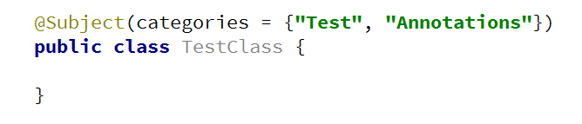
Problem: Create Annotation
Create annotation Subject with a String[] element "categories"
Should be available at runtime
Can be placed only on types

Slide 288
Solution: Create Annotation
@Target(ElementType.TYPE)
@Retention(RetentionPolicy.RUNTIME)
public @interface Subject {
String[] categories();
}

Slide 289
Annotations
Obtain class annotations
Obtain parameter annotations
Obtain fields and methods annotations
Annotation[] annotations = aClass.getAnnotations();
Annotation annotation = aClass.getAnnotation(MyAnno.class);
Annotation[][] parameterAnnotations =
method.getParameterAnnotations();
Annotation[] fieldAnots = field.getDeclaredAnnotations();
Annotation[] methodAnot = method.getDeclaredAnnotations();
Notes:
There are two ways to achieve abstraction
- Using Abstract Classes
- Using Interfaces

Slide 290
Accessing Annotation (1)
Some annotations can be accessed at runtime
@Author(name = "Gosho")
public class AuthoredClass {
public static void main(String[] args) {
Class cl = AuthoredClass.class;
Author author = (Author) cl.getAnnotation(Author.class);
System.out.println(author.name());
}
}

Slide 291
Accessing Annotation (2)
Some annotations can be accessed at runtime
Class cl = AuthoredClass.class;
Annotation[] annotations = cl.getAnnotations();
for (Annotation annotation : annotations) {
if (annotation.annotationType().equals(Author.class)) {
Author author = (Author) annotation;
System.out.println(author.name());
}
}

Slide 292
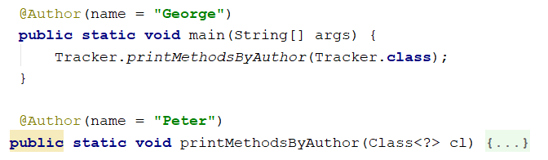
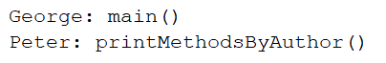
Problem: Coding Tracker
Create annotation Author with a String element "name"
Should be available at runtime
Should be placed only on methods
Create a class Tracker with a method:
public static void printMethodsByAuthor()

Slide 293
Solution: Coding Tracker (1)
public class Tracker {
public static void printMethodsByAuthor(Class<?> cl) {
Map<String, List<String>> methodsByAuthor = new HashMap<>();
Method[] methods = cl.getDeclaredMethods();
for (Method method : methods) {
Author annotation = method.getAnnotation(Author.class);
// Continues on next slide

Slide 294
Solution: Coding Tracker (2)
if (annotation != null) {
methodsByAuthor
.putIfAbsent(annotation.name(), new ArrayList<>());
methodsByAuthor
.get(annotation.name()).add(method.getName() + "()");
}
}
// TODO: print the results
}
}

Slide 295
Summary
What is Reflection
Reflection API
Reflecting Classes, Constructors, Fields, Methods
Access Modifiers
Annotations
Used to describe our code
Provide the possibility to work with non-existing classes
Can be accessed through reflection
…
…
…

Slide 296
Questions?
Notes:
296

Slide 297
SoftUni Diamond Partners

Slide 298
Educational Partners

Slide 299
Trainings @ Software University (SoftUni)
Software University – High-Quality Education, Profession and Job for Software Developers
softuni.bg
Software University Foundation
softuni.foundation
Software University @ Facebook
facebook.com/SoftwareUniversity
Software University Forums
forum.softuni.bg
299
Notes:
299

Slide 300
License
This course (slides, examples, demos, exercises, homework, documents, videos and other assets) is copyrighted content
Unauthorized copy, reproduction or use is illegal
© SoftUni – https://about.softuni.bg
© Software University – https://softuni.bg
Notes:
300

Slide 301

Exception Handling
Handling Errors During the Program Execution
SoftUni Team
Technical Trainers
Software University
https://softuni.bg

Slide 302
Table of Contents
What Are Exceptions?
The Exception Class
Types of Exceptions and Their Hierarchy
Handling Exceptions
Raising (Throwing) Exceptions
Best Practices
Creating Custom Exceptions

Slide 303
Have a Question?
sli.do
#java-advanced

Slide 304

What Are Exceptions?

Slide 305
What Are Exceptions?
Simplify code construction and maintenance
Allow the problematic situations to be processed at multiple levels
Exception objects have detailed information about the error
There are two ways to write error-free programs; only the third one works. (Alan J. Perlis)
305

Slide 306
The Throwable Class
Exceptions in Java are objects
The Throwable class is a base for all exceptions in JVM
Contains information for the cause of the error
Message – a text description of the exception
StackTrace – the snapshot of the stack at the moment of exception throwing
306

Slide 307
Types of Exceptions
Java exceptions inherit from Throwable
Below Throwable are:
Error - not expected to be caught under normal circumstances from the program
Example - StackOverflowError
Exception
Used for exceptional conditions that user programs should catch
User-defined exceptions

Slide 308
Exceptions
Exceptions are two types:
Checked - an exception that is checked (notified) by the compiler at compilation-time
Also called as Compile Time exceptions
Unchecked - an exception that occurs at the time of execution
Also called as Runtime Exceptions
public static void main(String args[]) {
File file = new File("E://file.txt");
FileReader fr = new FileReader(file);
}
FileNotFoundException

Slide 309
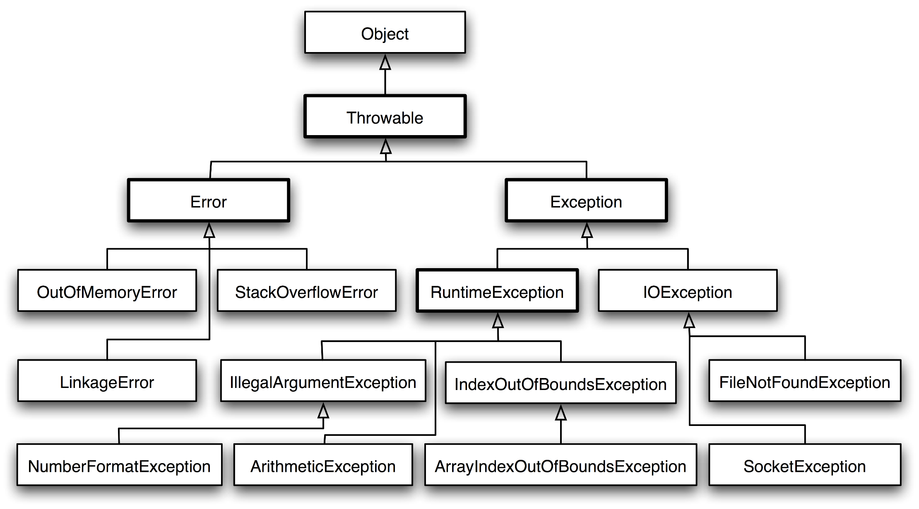
Exception Hierarchy
309

Slide 310

Handling Exceptions

Slide 311

Handling Exceptions
In Java exceptions can be handled by the try-catch construction
catch blocks can be used multiple times to process different exception types
try {
// Do some work that can raise an exception
} catch (SomeException) {
// Handle the caught exception
}
311

Slide 312
Multiple Catch Blocks – Example
String s = sc.nextLine();
try {
Integer.parseInt(s);
System.out.printf(
"You entered a valid integer number %s.", s);
} catch (NumberFormatException ex) {
System.out.println("Invalid integer number!");
}
312

Slide 313

Handling Exceptions
When catching an exception of a particular class, all its inheritors (child exceptions) are caught too, e.g.
Handles IndexOutOfBoundsException and its descendants ArrayIndexOutOfBoundsException and StringIndexOutOfBoundsException
try {
// Do some work that can cause an exception
} catch (IndexOutOfBoundsException ae) {
// Handle the caught arithmetic exception
}

Slide 314
Find the Mistake!
String str = sc.nextLine();
try {
Integer.parseInt(str);
} catch (Exception ex) {
System.out.println("Cannot parse the number!");
} catch (NumberFormatException ex) {
System.out.println("Invalid integer number!");
}
Should be last
Unreachable code

Slide 315
Handling All Exceptions
Unmanaged code can throw other exceptions
For handling all exceptions (even unmanaged) use the construction:
try {
// Do some work that can raise any exception
} catch (Exception ex) {
// Handle the caught exception
}

Slide 316
The Try-finally Statement
The statement:
Ensures execution of a given block in all cases
When exception is raised or not in the try block
Used for execution of cleaning-up code, e.g. releasing resources
try {
// Do some work that can cause an exception
} finally {
// This block will always execute
}

Slide 317
Try-finally – Example
static void testTryFinally() {
System.out.println("Code executed before try-finally.");
try {
String str = sc.nextLine();
Integer.parseInt(str);
System.out.println("Parsing was successful.");
return; // Exit from the current method
} catch (NumberFormatException ex) {
System.out.println("Parsing failed!");
} finally {
System.out.println("This cleanup code is always executed.");
}
System.out.println("This code is after the try-finally block.");
}

Slide 318
How Do Exceptions Work?
try
Run this code
catch
Execute this code when there is an exception
finally
Always run this code

Slide 319

Handling Exceptions

Slide 320

Throwing Exceptions

Slide 321
Throwing Exceptions
Exceptions are thrown (raised) by the throw keyword
Used to notify the calling code in case of an error or unusual situation
When an exception is thrown:
The program execution stops
The exception travels over the stack
Until a matching catch block is reached to handle it
Unhandled exceptions display an error message

Slide 322
Using Throw Keyword
Throwing an exception with an error message:
Exceptions can accept message and cause:
Note: if the original exception is not passed, the initial cause of the exception is lost
throw new IllegalArgumentException("Invalid amount!");
try {
…
} catch (SQLException sqlEx) {
throw new IllegalStateException("Cannot save invoice.", sqlEx);
}

Slide 323
Re-Throwing Exceptions
Caught exceptions can be re-thrown again:
try {
Integer.parseInt(str);
} catch (NumberFormatException ex) {
System.out.println("Parse failed!");
throw ex; // Re-throw the caught exception
}

Slide 324
Throwing Exceptions – Example
public static double sqrt(double value) {
if (value < 0)
throw new IllegalArgumentException(
"Sqrt for negative numbers is undefined!");
return Math.sqrt(value);
}
public static void main(String[] args) {
try {
sqrt(-1);
} catch (IllegalArgumentException ex) {
System.err.println("Error: " + ex.getMessage());
ex.printStackTrace();
}
}

Slide 325

Throwing Exceptions

Slide 326

Best Practices

Slide 327
Using Catch Block
Catch blocks should:
Begin with the exceptions lowest in the hierarchy
Continue with the more general exceptions
Otherwise a compilation error will occur
Each catch block should handle only these exceptions which it expects
If a method is not competent to handle an exception, it should leave it unhandled
Handling all exceptions disregarding their type is a popular bad practice (anti-pattern)!

Slide 328
Choosing the Exception Type (1)
When an application attempts to use null in a case where an object is required – NullPointerException
An array has been accessed with an illegal index – ArrayIndexOutOfBoundsException
An index is either negative or greater than the size of the string – StringIndexOutOfBoundsException
Attempts to convert a inappropriate string to one of the numeric types - NumberFormatException

Slide 329
Choosing the Exception Type (2)
When an exceptional arithmetic condition has occurred – ArithmeticException
Attempts to cast an object to a subclass of which it is not an instance – ClassCastException
A method has been passed an illegal or inappropriate argument - IllegalArgumentException

Slide 330


Exceptions – Best Practices (1)
When raising an exception, always pass to the constructor a good explanation message
When throwing an exception always pass a good description of the problem
The exception message should explain what causes the problem and how to solve it
Good: "Size should be integer in range [1…15]"
Good: "Invalid state. First call Initialize()"
Bad: "Unexpected error"
Bad: "Invalid argument"

Slide 331
Exceptions – Best Practices (2)
Exceptions can decrease the application performance
Throw exceptions only in situations which are really exceptional and should be handled
Do not throw exceptions in the normal program control flow
JVM could throw exceptions at any time with no way to predict them
E.g. StackOverflowError

Slide 332

Custom Exceptions

Slide 333
Creating Custom Exceptions
Custom exceptions inherit an exception class (commonly – Exception)
Thrown just like any other exception
public class TankException extends Exception {
public TankException(String msg) {
super(msg);
}
}
throw new TankException("Not enough fuel to travel");

Slide 334
Summary
…
…
…
Exceptions provide a flexible error handling mechanism
Unhandled exceptions cause error messages
try-finally ensures a given code block is always executed
Even when an exception is thrown

Slide 335
Questions?
Notes:
335

Slide 336
SoftUni Diamond Partners

Slide 337
Educational Partners

Slide 338
Trainings @ Software University (SoftUni)
Software University – High-Quality Education, Profession and Job for Software Developers
softuni.bg
Software University Foundation
softuni.foundation
Software University @ Facebook
facebook.com/SoftwareUniversity
Software University Forums
forum.softuni.bg
338
Notes:
338

Slide 339
License
This course (slides, examples, demos, exercises, homework, documents, videos and other assets) is copyrighted content
Unauthorized copy, reproduction or use is illegal
© SoftUni – https://about.softuni.bg
© Software University – https://softuni.bg
Notes:
339

Slide 340

Unit Testing
Building Rock-Solid Software
SoftUni Team
Technical Trainers
Software University
https://softuni.bg

Slide 341
Table of Contents
Seven Testing Principles
What Is Unit Testing?
Unit Testing Frameworks - JUnit
3A Pattern
Best Practices
Dependency Injection
Mocking and Mock Objects

Slide 342
Have a Question?
sli.do
#java-advanced

Slide 343
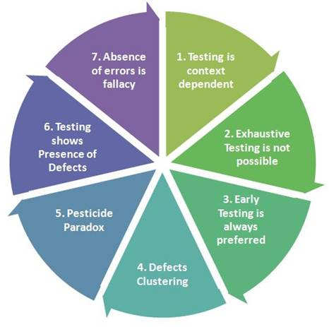
Seven Testing Principles

Slide 344
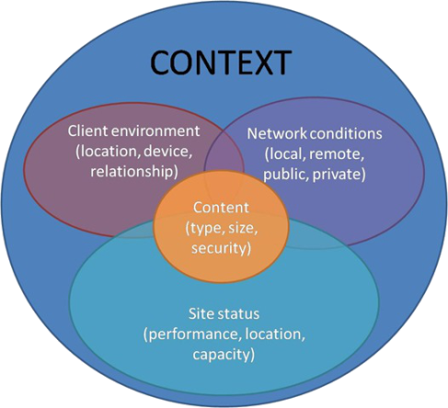
Seven Testing Principles (1)
Testing is context dependent
Testing is done differently in different contexts
Example:
Safety-critical software is tested differently from an e-commerce site
344

Slide 345
Seven Testing Principles (2)
Exhaustive testing is impossible
All combinations of inputs and preconditions are usually almost infinite number
Testing everything is not feasible
Except for trivial cases
Risk analysis and priorities should be used to focus testing efforts

Slide 346
Seven Testing Principles (3)
Defect clustering
Testing effort shall be focused proportionally
To the expected and later observed defect density of modules
A small number of modules usually contains most of the defects discovered
Responsible for most of the operational failures
Notes:
In your opinion which operation is most likely to cause your Operation system to fail?
- Opening Microsoft Word
- Open IE
- Opening 10 different application all at the same time

Slide 347
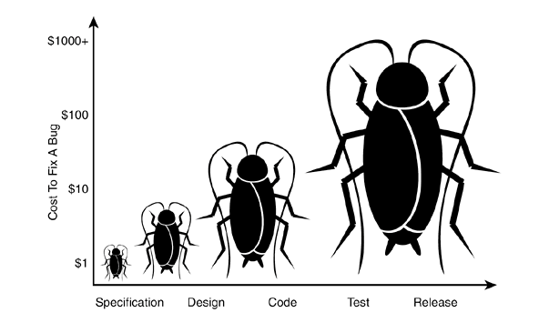
Seven Testing Principles (4)
Early testing is always preferred
Testing activities shall be started as early as possible
And shall be focused on defined objectives
The later a bug is found – the more it costs!

Slide 348
Seven Testing Principles (5)
Pesticide paradox
Same tests repeated over and over again tend to lose their effectiveness
Previously undetected defects remain undiscovered
New and modified test cases should be developed

Slide 349
Seven Testing Principles (6)
Testing shows presence of defects
Testing can show that defects are present
Cannot prove that there are no defects
Appropriate testing reduces the probability for defects

Slide 350
Seven Testing Principles (7)
Absence-of-errors fallacy
Finding and fixing defects itself does not help in these cases:
The system built is unusable
Does not fulfill the users needs and expectations

Slide 351

What is Unit Testing

Slide 352
Manual Testing (1)
Not structured
Not repeatable
Can't cover all of the code
Not as easy as it should be
void testSum() {
if (this.sum(1, 2) != 3) {
throw new Exception("1 + 2 != 3");
}
352

Slide 353
Manual Testing (2)
We need a structured approach that:
Allows refactoring
Reduces the cost of change
Decreases the number of defects in the code
Bonus:
Improves design

Slide 354
Automated Testing
System tests
Integration tests
Unit tests
The whole system
System
A single module
Integration
Unit
A single class

Slide 355

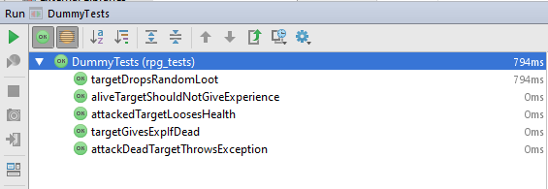
Junit (1)
The first popular unit testing framework
Most popular for Java development
Based on Java, written by Kent Beck & Co.

Slide 356
Junit (2)
Maven Repository – Junit 4.12
Copy JUnit repository and paste in pom.xml
<project …>
…
<dependencies>
<dependency>
<groupId>junit</groupId>
<artifactId>junit</artifactId>
<version>4.12</version>
<scope>test</scope>
</dependency>
</dependencies>
</project>

Slide 357
Junit – Writing Tests
Create new package (e.g. tests)
Create a class for test methods (e.g. BankAccountTests)
Create a public void method annotated with @Test
@Test
public void depositShouldAddMoney() {
/* magic */
}

Slide 358
3A Pattern
Arrange - Preconditions
Act - Test a single behavior
Assert - Postconditions
Each test should test a single behavior!
@Test
public void depositShouldAddMoney() {
BankAccount account = new BankAccount();
account.deposit(50);
Assert.assertTrue(account.getBalance() == 50)
}

Slide 359
Exceptions
Sometimes throwing an exception is the expected behavior
Assert
@Test(expected = IllegalArgumentException.class)
public void depositNegativeShouldNotAddMoney() {
BankAccount account = new BankAccount();
account.deposit(-50);
}
Arrange
Act

Slide 360

Problem: Test Axe
Create a Maven project
Add provided classes (Axe, Dummy, Hero) to project
In test/java folder, create a package rpg_tests
Create a class AxeTests
Create the following tests:
Test if weapon loses durability after attack
Test attacking with a broken weapon

Slide 361
Solution: Test Axe (1)
@Test
public void weaponLosesDurabilityAfterAttack() {
// Arrange
Axe axe = new Axe(10, 10);
Dummy dummy = new Dummy(10, 10);
// Act
axe.attack(dummy);
// Assert
Assert.assertTrue(axe.getDurabilityPoints() == 9);
}

Slide 362
Solution: Test Axe (2)
@Test(expected = IllegalStateException.class) // Assert
public void brokenWeaponCantAttack() {
// Arrange
Axe axe = new Axe(10, 1);
Dummy dummy = new Dummy(10, 10);
// Act
axe.attack(dummy);
axe.attack(dummy);
}

Slide 363

Problem: Test Dummy
Create a class DummyTests
Create the following tests
Dummy loses health if attacked
Dead Dummy throws exception if attacked
Dead Dummy can give XP
Alive Dummy can't give XP

Slide 364
Solution: Test Dummy
@Test
public void attackedTargetLoosesHealth() {
// Arrange
Dummy dummy = new Dummy(10, 10);
// Act
dummy.takeAttack(5);
// Assert
Assert.assertTrue(dummy.getHealth() == 5);
}
// TODO: Write the rest of the tests
There is a better solution…

Slide 365

Unit Testing Best Practices

Slide 366
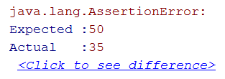
Assertions
assertTrue() vs assertEquals()
assertTrue()
assertEquals(expected, actual)
Assert.assertTrue(account.getBalance() == 50);
Assert.assertEquals(50, account.getBalance());
Better description when expecting value

Slide 367
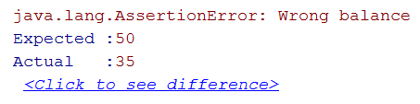
Assertion Messages
Assertions can show messages
Helps with diagnostics
Hamcrest is useful tool for test diagnostics
Assert.assertEquals(
"Wrong balance", 50, account.getBalance());
Helps finding the problem

Slide 368
Magic Numbers
Avoid using magic numbers (use constants instead)
private static final int AMOUNT = 50;
@Test
public void depositShouldAddMoney() {
BankAccount account = new BankAccount();
account.deposit(AMOUNT);
Assert.assertEquals("Wrong balance",
AMOUNT, account.getBalance());
}

Slide 369
@Before
Use @Before annotation
private BankAccount account;
@Before
public void createAccount() {
this.account = new BankAccount();
}
@Test
public void depositShouldAddMoney() { … }
Executes before each test

Slide 370


Naming Test Methods
Test names
Should use business domain terminology
Should be descriptive and readable
incrementNumber() {}
test1() {}
testTransfer() {}
depositAddsMoneyToBalance() {}
depositNegativeShouldNotAddMoney() {}
transferSubtractsFromSourceAddsToDestAccount() {}

Slide 371
Problem: Refactor Tests
Refactor the tests for Axe and Dummy classes
Make sure that:
Names of test methods are descriptive
You use appropriate assertions (assert equals vs assert true)
You use assertion messages
There are no magic numbers
There is no code duplication (Don’t Repeat Yourself)

Slide 372
Solution: Refactor Tests (1)
private static final int AXE_ATTACK = 10;
private static final int AXE_DURABILITY = 1;
private static final int DUMMY_HEALTH = 20;
private static final int DUMMY_XP = 10;
private Axe axe;
private Dummy dummy;
@Before
public void initializeTestObjects() {
this.axe = new Axe(AXE_ATTACK, AXE_DURABILITY);
this.dummy = new Dummy(DUMMY_HEALTH, DUMMY_XP); }

Slide 373
Solution: Refactor Tests (2)
@Test
public void weaponLosesDurabilityAfterAttack() {
this.axe.attack(this.dummy);
Assert.assertEquals("Wrong durability",
AXE_DURABILITY - 1,
axe.getDurabilityPoints()); }
@Test(expected = IllegalStateException.class)
public void brokenWeaponCantAttack() {
this.axe.attack(this.dummy);
this.axe.attack(this.dummy); }

Slide 374

Dependencies

Slide 375
Coupling and Testing (1)
Consider testing the following code:
We want to test a single behavior
Concrete Implementation
public class Bank {
private AccountManager accountManager;
public Bank() {
this.accountManager = new AccountManager();
}
public AccountInfo getInfo(String id) { … }
}
Bank depends on AccoutManager

Slide 376
Coupling and Testing (2)
Need to find solution to decouple classes
Interface
Bank inherits bugs
AccountManager
+Account getAccount()
Bank
AccountManager
uses
Bank

Slide 377
Dependency Injection
Decouples classes and makes code testable
Using Interface
interface AccountManager {
Account getAccount();
}
public class Bank {
private AccountManager accountManager;
public Bank(AccountManager accountManager) {
this.accountManager = accountManager;
}
}
Independent from Implementation
Injecting dependencies
377

Slide 378
Goal: Isolating Test Behavior
In other words, to fixate all moving parts
@Test
public void testGetInfoById() {
// Arrange
AccountManager manager = new AccountManager() {
public Account getAccount(String id) { … }
}
Bank bank = new Bank(manager);
AccountInfo info = bank.getInfo(ID);
// Assert… }
Anonymous class
Fake interface implementation with fixed behavior

Slide 379
Problem: Fake Axe and Dummy
Test if hero gains XP when target dies
To do this, first:
Make Hero class testable (use Dependency Injection)
Introduce Interfaces for Axe and Dummy
Interface Weapon
Interface Target
Create test using a fake Weapon and fake Dummy

Slide 380
Solution: Fake Axe and Dummy (1)
public interface Target {
void takeAttack(int attackPoints);
int getHealth();
int giveExperience();
boolean isDead();
}
public interface Weapon {
void attack(Target target);
int getAttackPoints();
int getDurabilityPoints(); }

Slide 381
Solution: Fake Axe and Dummy (2)
// Hero: Dependency Injection through constructor
public Hero(String name, Weapon weapon) {
this.name = name; /* Hero: Dependency Injection */
this.experience = 0; /* through constructor */
this.weapon = weapon; }
public class Axe implements Weapon {
public void attack(Target target) { … }
}
// Dummy: implement Target interface
public class Dummy implements Target { }

Slide 382
Solution: Fake Axe and Dummy (3)
@Test
public void heroGainsExperienceAfterAttackIfTargetDies() {
Target fakeTarget = new Target() {
public void takeAttack(int attackPoints) { }
public int getHealth() { return 0; }
public int giveExperience() { return TARGET_XP; }
public boolean isDead() { return true; }
};
// Continues on next slide…

Slide 383
Solution: Fake Axe and Dummy (4)
// …
Weapon fakeWeapon = new Weapon() {
public void attack(Target target) {}
public int getAttackPoints() { return WEAPON_ATTACK; }
public int getDurabilityPoints() { return 0; }
};
Hero hero = new Hero(HERO_NAME, fakeWeapon);
hero.attack(fakeTarget);
// Assert…
}

Slide 384
Fake Implementations
Not readable, cumbersome and boilerplate
@Test
public void testRequiresFakeImplementationOfBigInterface() {
// Arrange
Database db = new BankDatabase() {
// Too many methods…
};
AccountManager manager = new AccountManager(db);
// Act & Assert…
}
Not suitable for big interfaces

Slide 385

Mocking
Mock objects simulate behavior of real objects
Supplies data exclusively for the test - e.g. network data, random data, big data (database), etc.
@Test
public void testAlarmClockShouldRingInTheMorning() {
Time time = new Time();
AlarmClock clock = new AlarmClock(time);
if (time.isMorning()) {
Assert.assertTrue(clock.isRinging());
} }
Test will pass only in the morning!

Slide 386
Mockito
Mockito Web Site - Mockito 3.0.0 dependency
Copy dependency in pom.xml
<dependency>
<groupId>org.mockito</groupId>
<artifactId>mockito-core</artifactId>
<version>3.0.0</version>
<scope>test</scope>
</dependency>

Slide 387
Mockito
Framework for mocking objects
@Test
public void testAlarmClockShouldRingInTheMourning() {
Time mockedTime = Mockito.mock(Time.class);
Mockito.when(mockedTime.isMorning()).thenReturn(true);
AlarmClock clock = new AlarmClock(mockedTime);
if (mockedTime.isMorning()) {
Assert.assertTrue(clock.isRinging());
}
}
Always true

Slide 388
Problem: Mocking
Include Mockito in the project dependencies
Mock fakes from previous problem
Implement Hero Inventory, holding unequipped weapons
method - Iterable<Weapon> getInventory()
Implement Target giving random weapon upon death
field - private List<Weapon> possibleLoot
Test Hero killing a target getting loot in his inventory
Test Target drops random loot

Slide 389
Solution: Mocking (1)
@Test
public void attackGainsExperienceIfTargetIsDead() {
Weapon weaponMock = Mockito.mock(Weapon.class);
Target targetMock = Mockito.mock(Target.class);
Mockito.when(targetMock.isDead()).thenReturn(true);
Mockito.when(targetMock.giveExperience()).thenReturn(TARGET_XP);
Hero hero = new Hero(HERO_NAME, weaponMock);
hero.attack(targetMock);
Assert.assertEquals("Wrong experience", TARGET_XP,
hero.getExperience());
}

Slide 390
Solution: Mocking (2)
Create RandomProvider Interface
Hero method
attack(Target target, RandomProvider rnd)
Target method
dropLoot(RandomProvider rnd)
Mock weapon, target and random provider for test

Slide 391
Summary
Unit Testing helps us build solid code
Structure your unit tests – 3A Pattern
Use descriptive names for your tests
Use different assertions depending on the situation
Dependency Injection
makes your classes testable
Looses coupling and improves design
Mock objects to isolate tested behavior
…
…
…
What is Reflection
Reflection API
Reflecting Classes
Reflecting Constructors
Reflecting Fields
Reflecting Methods
Access Modifiers
Annotations are used to describe our code
Annotations provide the possibility to work with non-existing classes
Some annotations can be accessed through reflection

Slide 392
Questions?
Notes:
392

Slide 393
SoftUni Diamond Partners

Slide 394
Educational Partners

Slide 395
Trainings @ Software University (SoftUni)
Software University – High-Quality Education, Profession and Job for Software Developers
softuni.bg
Software University Foundation
softuni.foundation
Software University @ Facebook
facebook.com/SoftwareUniversity
Software University Forums
forum.softuni.bg
395
Notes:
395

Slide 396
License
This course (slides, examples, demos, exercises, homework, documents, videos and other assets) is copyrighted content
Unauthorized copy, reproduction or use is illegal
© SoftUni – https://about.softuni.bg
© Software University – https://softuni.bg
Notes:
396

Slide 397

Test-Driven Development
Learn the "Test First" Approach to Coding
SoftUni Team
Technical Trainers
Software University
https://softuni.bg

Slide 398
Table of Contents
Code and Test
Test-Driven Development
Reasons to Use Test-Driven Development

Slide 399
Have a Question?
sli.do
#java-advanced

Slide 400

Test-Driven Development

Slide 401
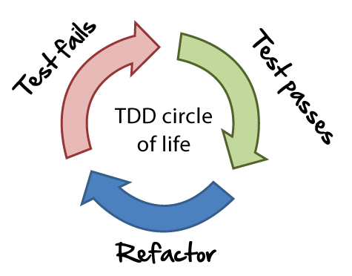
Unit Testing Approaches
"Code First" (code and test) approach
Classical approach
"Test First" approach
Test-driven development (TDD)
401

Slide 402
The Code and Test Approach
Write code
Write unit test
Run and succeed
Time flow

Slide 403
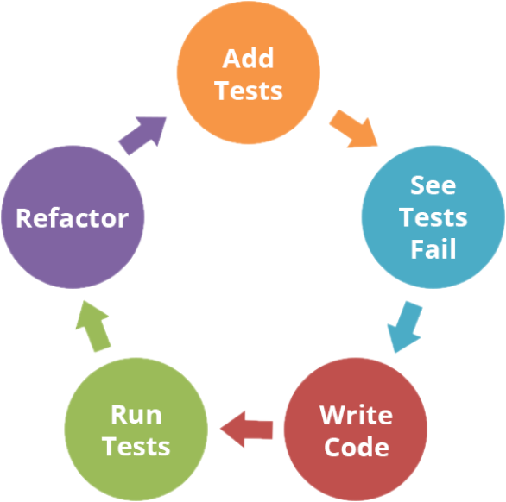
The Test-Driven Development Approach

Slide 404
Test-Driven Development (TDD)
Create a test list
Pick а test
Write test
Compile and fail
Write enough code to compile
Run test and fail
Write code to pass test
Time flow
Remove duplication

Slide 405

Why TDD?
TDD helps find design issues early
Avoids reworking
Writing code to satisfy a test is a focused activity
Less chance of error
Tests will be more comprehensive than if they are written after the code
405

Slide 406
Summary
…
…
…
Code and Test
Write code, then test it
Test-Driven Development
Write tests first
Reasons to use TDD
Prevent some application design flaws
Manage complexity more easily

Slide 407
Questions?
Notes:
407

Slide 408
SoftUni Diamond Partners

Slide 409
Educational Partners

Slide 410
Trainings @ Software University (SoftUni)
Software University – High-Quality Education, Profession and Job for Software Developers
softuni.bg
Software University Foundation
softuni.foundation
Software University @ Facebook
facebook.com/SoftwareUniversity
Software University Forums
forum.softuni.bg
410
Notes:
410

Slide 411
License
This course (slides, examples, demos, exercises, homework, documents, videos and other assets) is copyrighted content
Unauthorized copy, reproduction or use is illegal
© SoftUni – https://about.softuni.bg
© Software University – https://softuni.bg
Notes:
411

Slide 412

Design Patterns
SoftUni Team
Technical Trainers
Software University
https://softuni.bg

Slide 413
Table of Contents
Definition of Design Patterns
Benefits and Drawbacks
Types of Design Patterns
Creational
Structural
Behavioral

Slide 414
Have a Question?
sli.do
#java-advanced

Slide 415

Design Patterns

Slide 416
What Are Design Patterns?
General and reusable solutions to common problems in software design
A template for solving given problems
Add additional layers of abstraction in order to reach flexibility
416

Slide 417
What Do Design Patterns Solve?
Patterns solve software structural problems like:
Abstraction
Encapsulation
Separation of concerns
Coupling and cohesion
Separation of interface and implementation
Divide and conquer
417

Slide 418
Elements of a Design Pattern
Pattern name - Increases vocabulary of designers
Problem - Intent, context and when to apply
Solution - Abstract code
Consequences - Results and trade-offs
418

Slide 419

Why Design Patterns?

Slide 420

Benefits
Names form a common vocabulary
Enable large-scale reuse of software architectures
Help improve developer communication
Help ease the transition to Object Oriented technology
Can speed-up the development
420

Slide 421

Drawbacks
Do not lead to a direct code reuse
Deceptively simple
Developers may suffer from pattern overload and overdesign
Validated by experience and discussion, not by automated testing
Should be used only of understood well
421

Slide 422



Types of Design Patterns

Slide 423
Main Types
Creational patterns
Deal with initialization and configuration of classes and objects
Structural patterns
Describe ways to assemble objects to implement new functionality
Composition of classes and objects
Behavioral patterns
Deal with dynamic interactions among societies of classes
Distribute responsibility
423

Slide 424

Creational Patterns

Slide 425
Purposes
Deal with object creation mechanisms
Trying to create objects in a manner suitable to the situation
Two main ideas
Encapsulating knowledge about which classes the system uses
Hiding how instances of these classes are created
425

Slide 426
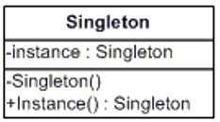
Singleton Pattern
The most often used creational design pattern
A Singleton class is supposed to have only one instance
It is not a global variable
Possible problems
Lazy loading
Thread-safe

Slide 427
Double-Check Singleton Example
class SerializableSingleton implements Serializable {
private static SerializableSingleton instance;
private SerializableSingleton() {}
public static synchronized SerializableSingleton getInstance() {
if(instance == null) {
instance = new SerializableSingleton();
}
return instance;
}
}
427

Slide 428
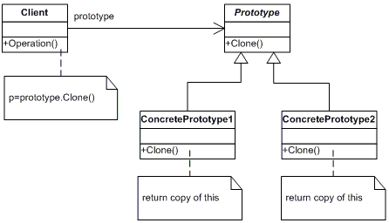
Prototype Pattern
Factory for cloning new instances from a prototype
Create new objects by copying this prototype
Instead if using the "new" keyword
Cloneable interface acts as Prototype

Slide 429
The Prototype Abstract Class
public abstract class Prototype {
private String id;
public Prototype(String id) {
this.id = id; }
public String getId() { return this.id; }
public abstract Prototype clone();
}
429

Slide 430
A Concrete Prototype Class
class ConcretePrototype extends Prototype {
public ConcretePrototype(string id) {
super(id);
}
@Override
public Prototype clone() {
return (Prototype)this.clone(); }
}
430

Slide 431
Builder Pattern
Separates the construction of a complex object from its representation
Same construction process can create different representations
Provides control over steps of construction process

Slide 432
Example: Computer Class
public class Computer {
private String RAM;
private boolean isGraphicsCardEnabled;
public String getRAM() { return RAM; }
public boolean isGraphicsCardEnabled() {
return isGraphicsCardEnabled;
}
public Computer(String ram, boolean isGraphicsCardEnabled) {
this.RAM = ram;
this.isGraphicsCardEnabled = isGraphicsCardEnabled;
}
}
432

Slide 433
Example: ComputerBuilder Class
public class ComputerBuilder{
private String RAM;
private boolean isGraphicsCardEnabled;
public ComputerBuilder(String ram){ this.RAM = ram; }
public ComputerBuilder setGraphicsCardEnabled(
boolean isGraphicsCardEnabled) {
this.isGraphicsCardEnabled = isGraphicsCardEnabled;
return this; }
public Computer build(){
return new Computer(this.RAM, this.isGraphicsCardEnabled);
} }
433

Slide 434

Structural Patterns

Slide 435
Purposes
Describe ways to assemble objects to implement a new functionality
Ease the design by identifying a simple way to realize relationship between entities
All about Class and Object composition
Inheritance to compose interfaces
Ways to compose objects to obtain new functionality
435

Slide 436
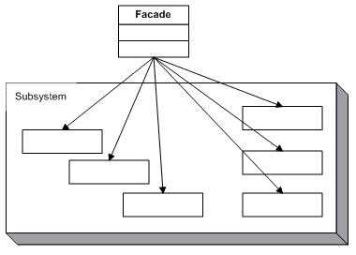
Façade Pattern
Provides a unified interface to a set of interfaces in a subsystem
Defines a higher-level interface that makes the subsystem easier to use

Slide 437
The Façade Class (1)
class Facade {
private SubSystemOne one;
private SubSystemTwo two;
public Facade() {
one = new SubSystemOne();
two = new SubSystemTwo();
}
437

Slide 438
The Façade Class (2)
public void MethodA() {
System.out.println("\nMethodA() ---- ");
one.MethodOne();
two.MethodTwo(); }
public void MethodB() {
System.out.println("\nMethodB() ---- ");
two.MethodTwo(); }
}
438

Slide 439
Subsystem Classes
class SubSystemOne {
public void MethodOne() {
System.out.println(" SubSystemOne Method"); }
}
class SubSystemTwo {
public void MethodTwo() {
System.out.println(" SubSystemTwo Method"); }
}
439

Slide 440
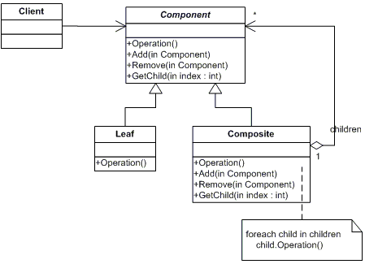
Composite Pattern
Allows to combine different types of objects in tree structures
Gives the possibility to treat the same object(s)
Used when
You have different objects that you want to treat the same way
You want to present hierarchy of objects

Slide 441
The Component Abstract Class
abstract class Component {
protected String name;
public Component(String name) {
this.name = name; }
public abstract void add(Component c);
public abstract void remove(Component c);
public abstract void display(int depth);
}
441

Slide 442
The Composite Class (1)
class Composite extends Component {
private List<Component> children = new ArrayList<Component>();
public Composite(String name) { super(name); }
@Override
public void add(Component component) {
children.add(component); }
@Override
public void remove(Component component) {
children.Remove(component); }
442

Slide 443
The Composite Class (2)
@Override
public void display(int depth) {
System.out.println(printNameInDepth(depth, name);
foreach (Component component : children) {
component.display(depth + 2);
}
}
public void printNameInDepth(int depth, String name) {
for(int i = 0; i < depth; i++)
System.out.print("-");
System.out.print(name);
}
443

Slide 444
The Leaf Class
class Leaf extends Component {
public Leaf(String name) { super(name); }
@Override
public void add(Component c) {
System.out.println("Cannot add to a leaf"); }
@Override
public void Remove(Component c) {
System.out.println("Cannot remove from a leaf"); }
@Override
public void Display(int depth) {
System.out.println(printNameInDepth(depth, name); }
}
444

Slide 445

Behavioral Patterns

Slide 446
Purposes
Concerned with interaction between objects
Either with the assignment of responsibilities between objects
Or encapsulating behavior in an object and delegating requests to it
Increases flexibility in carrying out cross-classes communication
446

Slide 447
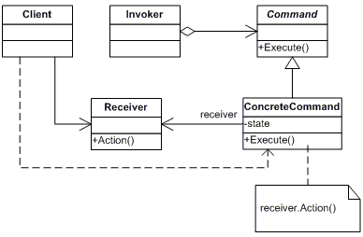
Command Pattern
An object encapsulates all the information needed to call a method at a later time
Lets you parameterize clients with different requests, queue or log requests, and support undoable operations

Slide 448
The Command Abstract Class
abstract class Command {
protected Receiver receiver;
public Command(Receiver receiver) {
this.receiver = receiver; }
public abstract void execute();
}
448

Slide 449
Concrete Command Class
class ConcreteCommand extends Command {
public ConcreteCommand(Receiver receiver) {
super(receiver); }
@Override
public void execute() {
receiver.action(); }
}
449

Slide 450
The Receiver Class
class Receiver {
public void action() {
System.out.println("Called Receiver.action()");
}
}
450

Slide 451
The Invoker Class
class Invoker {
private Command command;
public void setCommand(Command command) {
this.command = command; }
public void ExecuteCommand() {
command.execute(); }
}
451

Slide 452
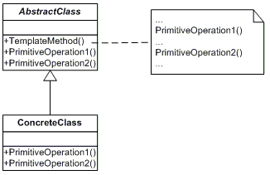
Template Pattern
Define the skeleton of an algorithm in a method, leaving some implementation to its subclasses
Allows the subclasses to redefine the implementation of some of the parts of the algorithm, but not its structure

Slide 453
The Abstract Class
abstract class AbstractClass {
public abstract void primitiveOperation1();
public abstract void primitiveOperation2();
public void templateMethod() {
primitiveOperation1();
primitiveOperation2();
System.out.println(""); }
}
453

Slide 454
A Concrete Class
class ConcreteClassA extends AbstractClass {
@Override
public void primitiveOperation1() {
System.out.println("ConcreteClassA.primitiveOperation1()"); }
@Override
public void primitiveOperation2() {
System.out.println("ConcreteClassA.primitiveOperation2()");
}
454

Slide 455
Summary
…
…
…
Design Patterns
Provide solution to common problems
Add additional layers of abstraction
Three main types of Design Patterns
Creational
Structural
Behavioral

Slide 456
Questions?
Notes:
456

Slide 457
SoftUni Diamond Partners

Slide 458
Educational Partners

Slide 459
Trainings @ Software University (SoftUni)
Software University – High-Quality Education, Profession and Job for Software Developers
softuni.bg
Software University Foundation
softuni.foundation
Software University @ Facebook
facebook.com/SoftwareUniversity
Software University Forums
forum.softuni.bg
459
Notes:
459

Slide 460
License
This course (slides, examples, demos, exercises, homework, documents, videos and other assets) is copyrighted content
Unauthorized copy, reproduction or use is illegal
© SoftUni – https://about.softuni.bg
© Software University – https://softuni.bg
Notes:
460

